Slide 1
Preclinical model: Oxygen-induced retinopathy in mice
A TRANSLATIONAL APPROACH TO PRECLINICAL RESEARCH
Comparative Biosciences, Inc.
786 Lucerne Drive
Sunnyvale, CA 94085
Telephone: 408.738.9260
www.compbio.com

Slide 2
Comparative Biosciences, Inc.
A TRANSLATIONAL APPROACH TO PRECLINICAL RESEARCH
Premier Preclinical Contract
Research Organization
20 years of experience
Conveniently located in the heart of Silicon Valley, amidst many biotech companies
State of the art, purpose-built facility
Approximately 30 employees
Highly experienced staff
GLP, OECD, FDA, USDA, OLAW
AAALAC Accreditation

Slide 3
Scientific Overview
A TRANSLATIONAL APPROACH TO PRECLINICAL RESEARCH
We specialize in developing a custom study plan in order to best meet your pre-clinical research needs and prepare for regulatory submission.
GLP and Non-GLP
Toxicology
Efficacy
Pharmacokinetics
Pharmacology
Oncology Studies
In-house histopathology, immunohistochemistry & TCR

Slide 4
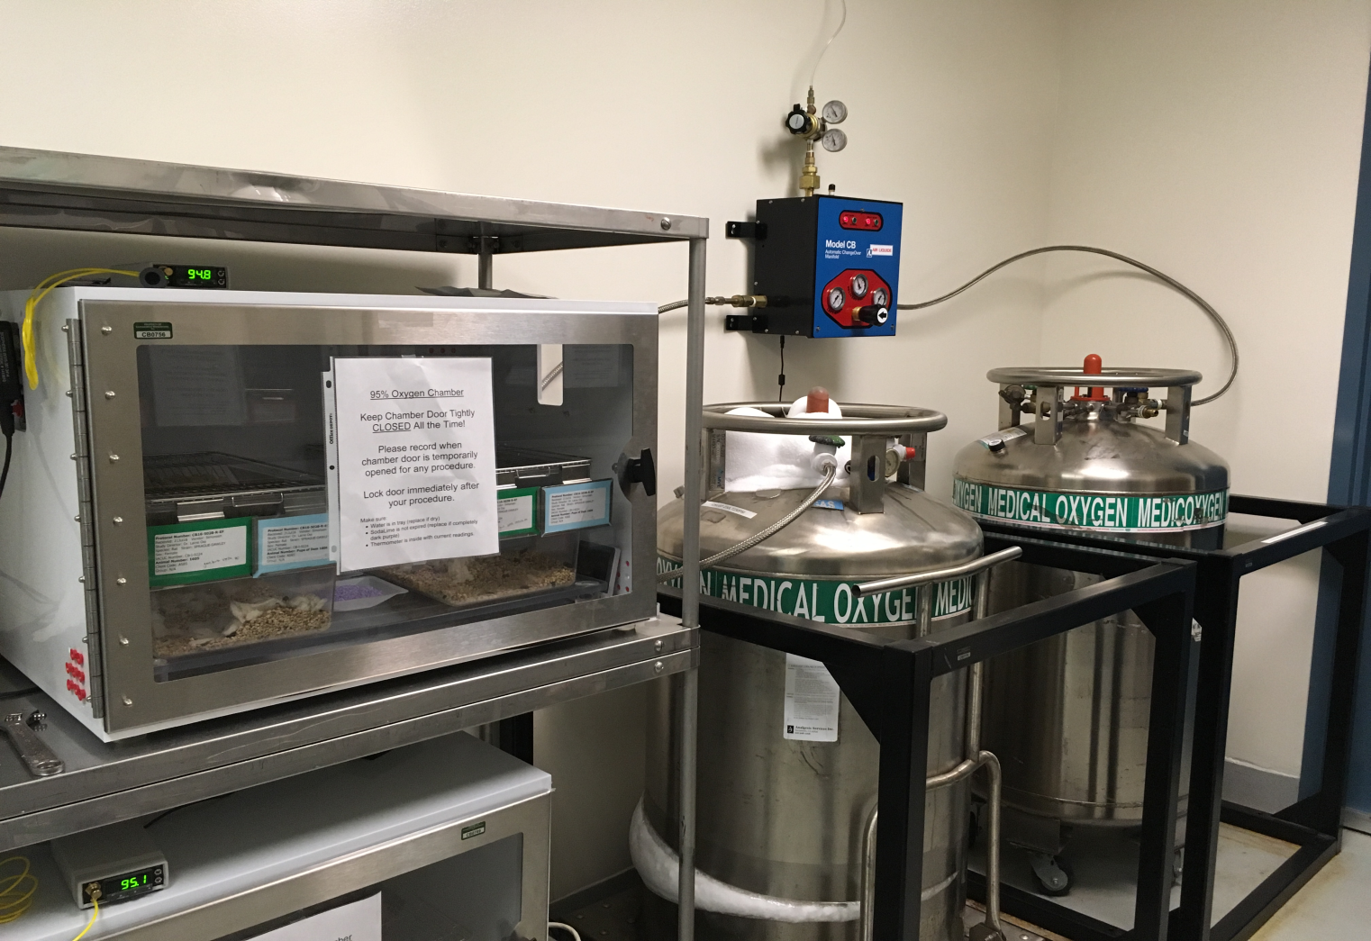
Preclinical model: Oxygen-induced retinopathy in mice
A TRANSLATIONAL APPROACH TO PRECLINICAL RESEARCH
OIR in mouse or rat pups validated model assessing new vessel formation.
Pups placed in a high/low oxygen chamber for species appropriate duration and oxygen concentration
Treatment administered at appropriate time intervals.
OCT may be conducted during in life to assess in vivo retinal changes
Eyes collected for pathologic examination or FITC whole mount preparation.
Routine staining, special staining, immunohistochemistry
Retinal proliferative plaques identified and measured by any of several methods.
Dimensions of neovascular plaque
proliferation compared between control
and treatment groups.

Slide 5
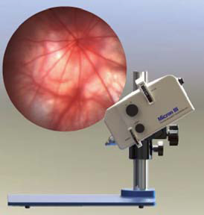
Preclinical model: Oxygen-induced retinopathy in mice
A TRANSLATIONAL APPROACH TO PRECLINICAL RESEARCH
The OIR model in hyper-oxygenated neonatal mouse or rat pups is a robust and established model to investigate new vessel proliferation in the retina. This is a model for several important ocular disorders such as age-related macular degeneration, retinopathy of prematurity, and various spontaneous retinal disorders in which retinal vascular disorders are prominent.

Slide 6
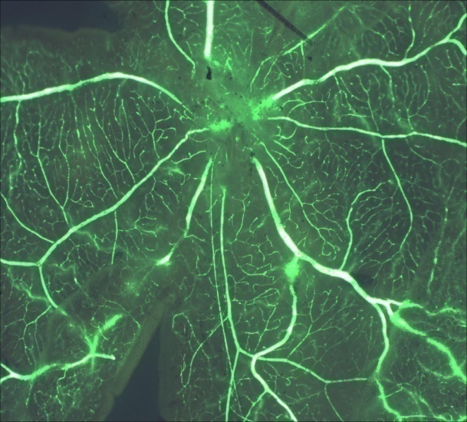
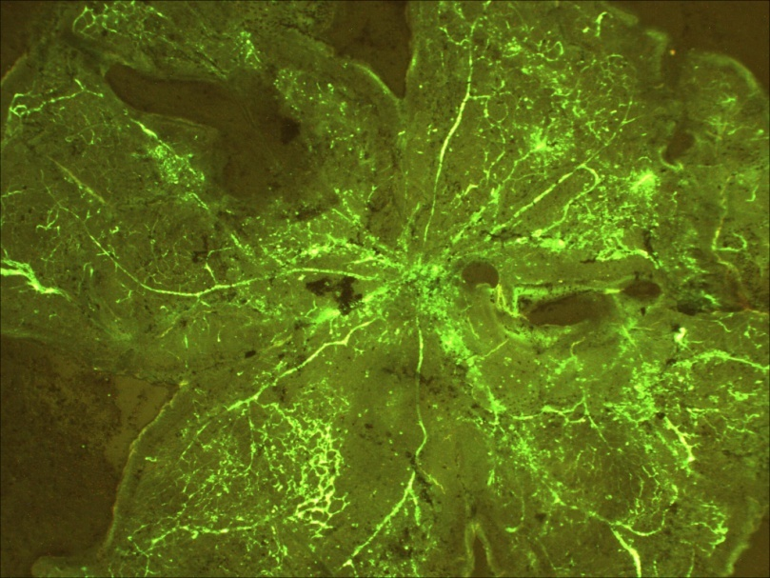
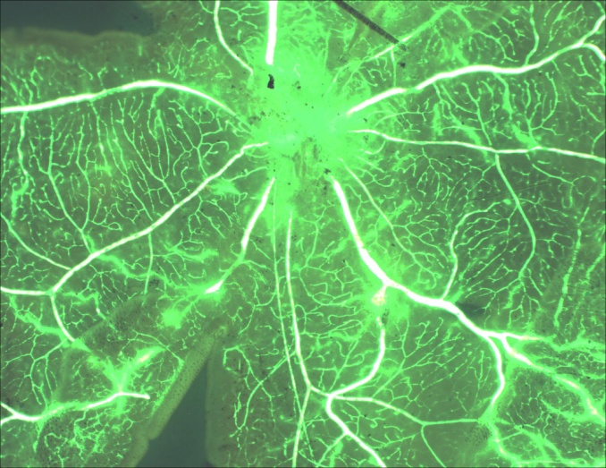
Retinal Flat Mounts from Hyper-oxygenated Mouse Pups
A TRANSLATIONAL APPROACH TO PRECLINICAL RESEARCH
Top Left: Normal retina from age-matched normo-air rat pup.
Hyper-oxygenated retina demonstrating vascular proliferation and leakage.
Triamcinolone-treated hyper-oxygenated retina showing a reduction in the amount of leakage and vascular leakage.

Slide 7
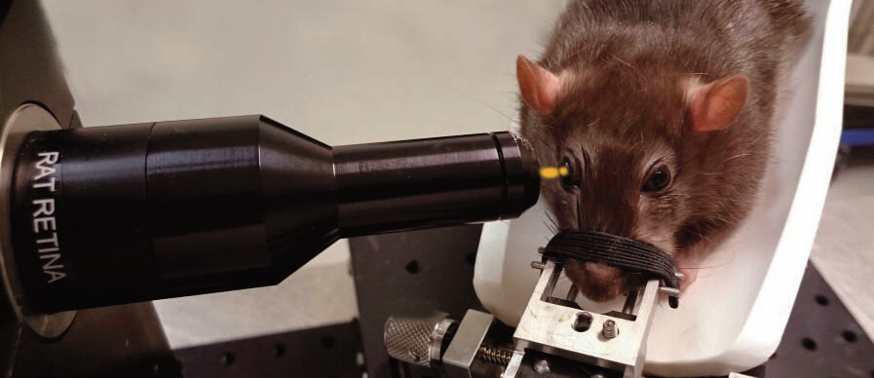
Optical Coherence Tomography
A TRANSLATIONAL APPROACH TO PRECLINICAL RESEARCH
Bioptigen Envisu R-Class System (for preclinical studies)
OCT has several benefits and its inclusion in ocular toxicology, pharmacokinetic and pharmacology studies should be considered:
Noninvasive - only requires brief immobilization
Facilitates longitudinal, real time and repetitive tracking of ocular changes, in particular retinal neovascular proliferations, sub retinal injections, stem cell implants, intraocular implants, retinal changes, and tumors.
Reveals or detects subtle retinal or ocular changes that are not visible with slit lamp biomicroscopy or funduscopy
Retinal tufts and proliferation visible with OCT
Contributes to improved clinical trial design

Slide 8
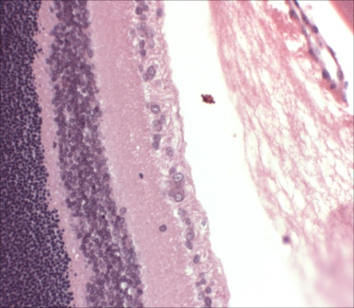
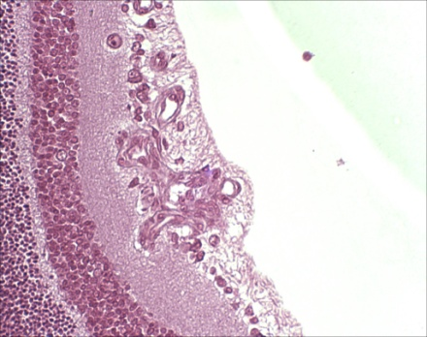
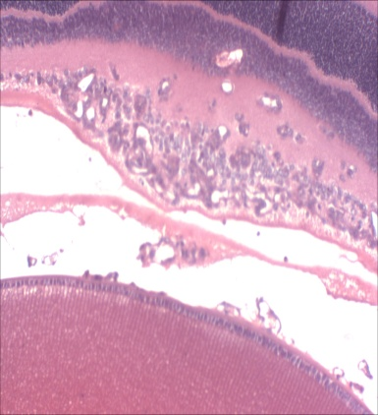
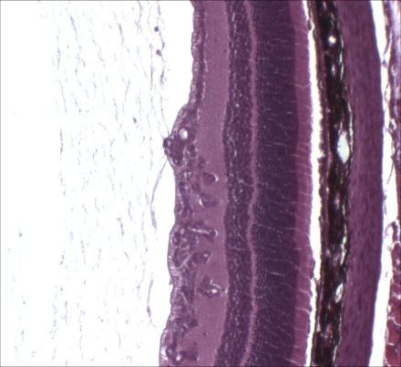
Retinal Histopathology in Hyperoxygenated Mouse Pups
A TRANSLATIONAL APPROACH TO PRECLINICAL RESEARCH
Top left: Normal retina from age matched mouse pup in normal air
Top right and bottom left: Hyper-oxygenated with vehicle treatment: There are large numbers of new vessel cross-sections proliferating on the surface of the retina and extending into the vitreous
Bottom right: Hyper-oxygenated with dexamethasone treatment: There are reduced numbers of vessel cross sections.

Slide 9
Neovascular cell counts in hyperoxygenated retinas
A TRANSLATIONAL APPROACH TO PRECLINICAL RESEARCH
Mice were treated with vehicle, dexamethasone, and a test articles
New vessel cross sections on the surface of the retina and within the vitreous were counted
Four eye sections for each mouse and 8 mice per group were examined for a total of 32 eyes per group
Dexamethasone and VEGF AB markedly and statistically educe the number of new vessels in the eye in comparison to the vehicle control
The test article also demonstrated activity

Slide 10
Assessment of retinal new vessel formation in hyperoxygenated mice
showing number of vessel cross-sections. Horizontal bars show group means.
* Statistically significant compared to hyperoxygenated untreated control group.

Slide 11
Assessment of retinal new vessel tuft formation in hyperoxygenated mice showing number of vessel cross-sections. Horizontal bars show group means. * Statistically significant compared to hyperoxygenated untreated control group.

Slide 12
Service and Quality
A TRANSLATIONAL APPROACH TO PRECLINICAL RESEARCH
The people at CBI—from the executive team to the study directors to the research associates expect to have to earn your trust and business.
Our ratio of scientists to non-scientists is one of the highest in the industry. We believe in sound science and every study director is a PhD-level scientist
Thoroughness in planning and execution is key to a successful study. All protocols are vetted and approved by multiple personnel. Our QAU has a rigorous training program. All non-GLP studies are conducted in the spirit of GLP with the same SOPs.
We believe in communication: timely responses to your inquiries and frequent updates on your study are mandatory.
Rapid initiation and adjustments; with the collective expertise of must larger organizations but the flexibility of a smaller more nimble group.
You are always welcome at CBI to meet the staff, tour the laboratory and discuss the progress and results of your study.

Slide 13
Our Staff
A TRANSLATIONAL APPROACH TO PRECLINICAL RESEARCH
Study Directors
PhD level scientists
Appointed by management for each job
Serves as single point of control and is responsible and accountable for study conduct and scientific interpretation
Experienced attentive and communicative
Rapid study initiation and report preparation
Research Associates
Bachelor Level Scientists
Extensive technical training
Quality Assurance
Full time, dedicated
Rigorous training program
CBI Management
Experienced senior scientific management-with large and small pharma experience

Slide 14
Summary
A TRANSLATIONAL APPROACH TO PRECLINICAL RESEARCH
With a focus on quality, CBI provides state of the art:
Toxicology
Pharmacokinetics
Efficacy
Pharmacology
In house histopathology
Experienced attentive and communicative study directors
Rapid study initiation and report preparation
Established, stable business
Regulatory compliance
Favorable pricing structure

