Slide 1
CBI Histomorphometric Measurement of Hyper-oxygenation Model of Bronchopulmonary Dysplasia: Validation of Phase Contrast Methodology
A TRANSLATIONAL APPROACH TO PRECLINICAL RESEARCH
Alireza Ebrahimnejad, PhD
Carol Meschter, DVM, PhD, DACVP
Comparative Biosciences, Inc.
786 Lucerne Drive
Sunnyvale, CA 94085
Telephone: 408.738.9260
www.compbio.com

Slide 2
Bronchopulmonary Dysplasia
A TRANSLATIONAL APPROACH TO PRECLINICAL RESEARCH
Hyper-oxygenation of neonatal rat pups is an established model of bronchopulmonary dysplasia
Prematurity, toxic lung injury, smoke inhalation
Assessments of treatment: Pulmonary function and MLI is the typical parameters assessed
CBI has developed and validated a method of assessment of the alveolar changes using a method of histomorphometric phase analysis based upon Jacob, et al. 2009
This models offers a superior and more sophisticated method to assess changes in morphology is comparison to MLI determinations

Slide 3
Hyper-oxygenation Model
A TRANSLATIONAL APPROACH TO PRECLINICAL RESEARCH
New born rat pups are placed in a high oxygen environment in a hyperoxic tank with their dams for 2 weeks
CBI has developed special proprietary methods of management of pups and dams
Following removal, over a period of 1-2 weeks, alveolar walls are damaged and become thickened and fibrotic with accompanying inflammation
Alveolar walls appear thickened, and the alveolar spaces appear to be dilated.
Lesions and MLI data are compatible with literature (vonHaaften, 2009)

Slide 4
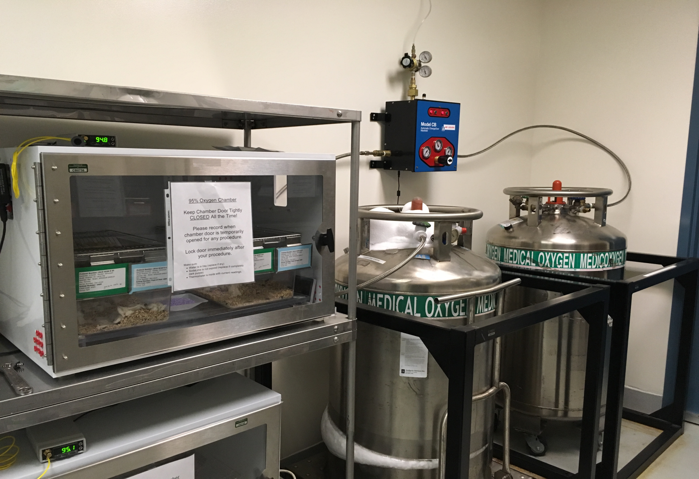
Hyper-oxygenation Model Hyper oxygen chamber used a CBI
A TRANSLATIONAL APPROACH TO PRECLINICAL RESEARCH

Slide 5
Hyper-oxygenation Model Histologic Findings in Bronchopulmonary Dysplasia
A TRANSLATIONAL APPROACH TO PRECLINICAL RESEARCH
Histology is the main assessment in this model
Multifocal areas of pulmonary fibrosis-with increases in alveolar thickness with accompanying inflammation
Decreases in alveolar lumen size with increased alveolar wall thickness with inflammation is present.
Immunohistochemical changes of increases in
alveolar wall collagen I
numbers of alveolar macrophages
new capillary growth
PCNA expression

Slide 6
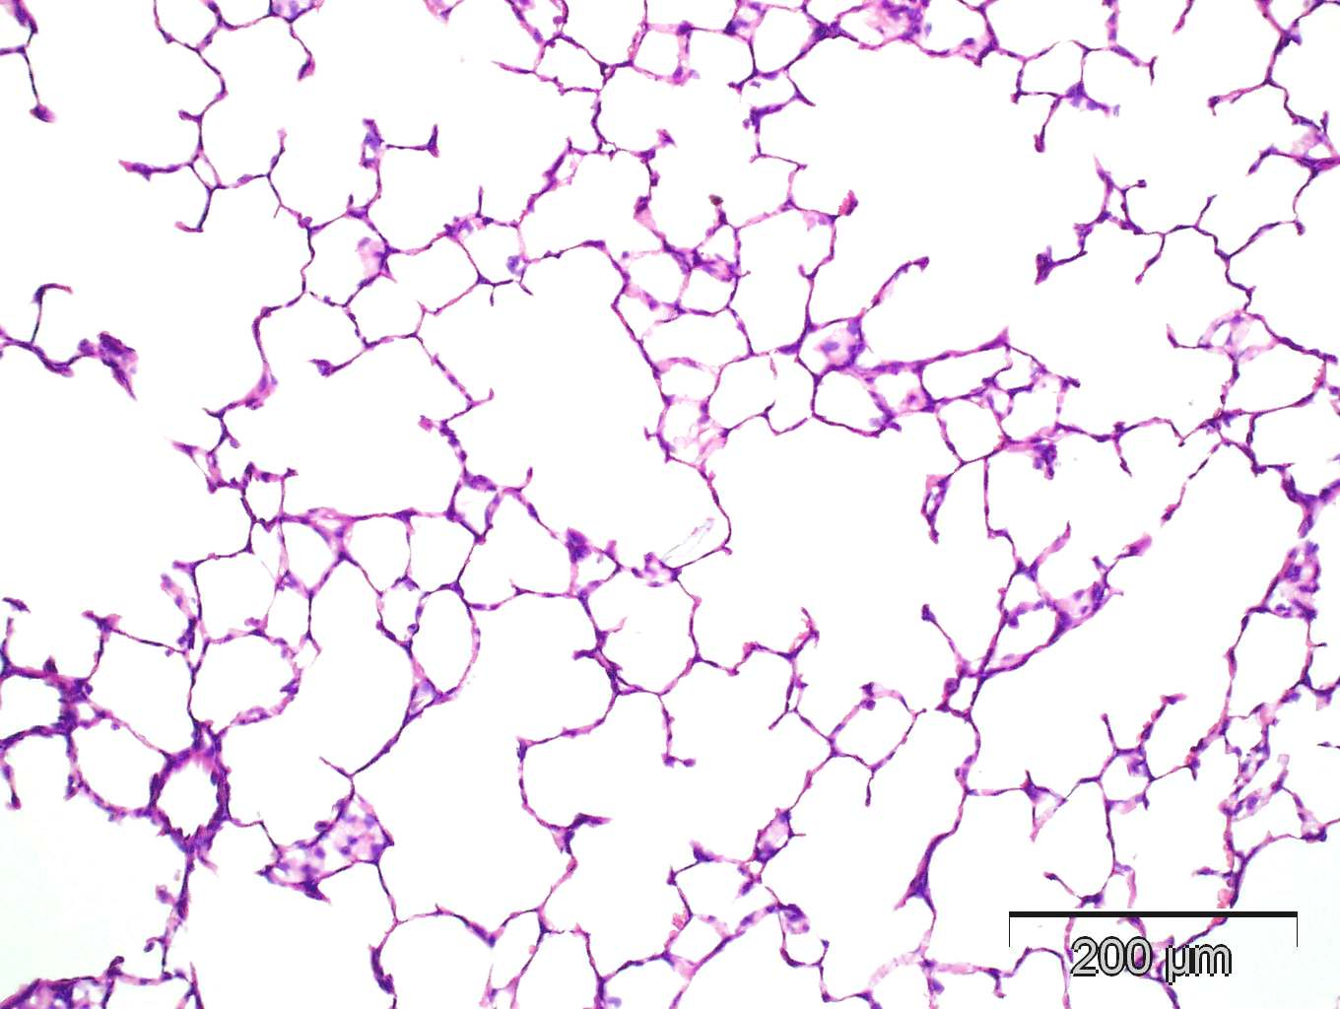
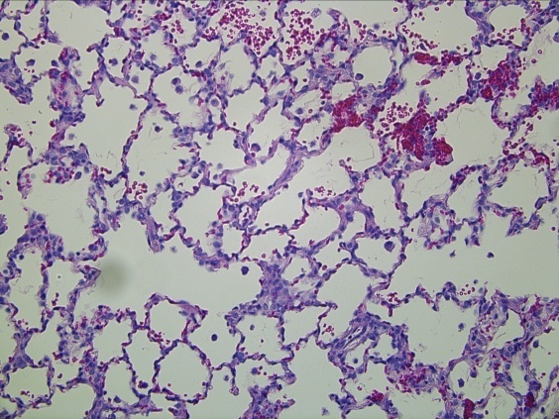
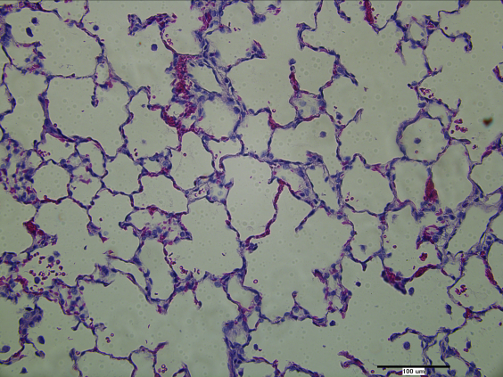
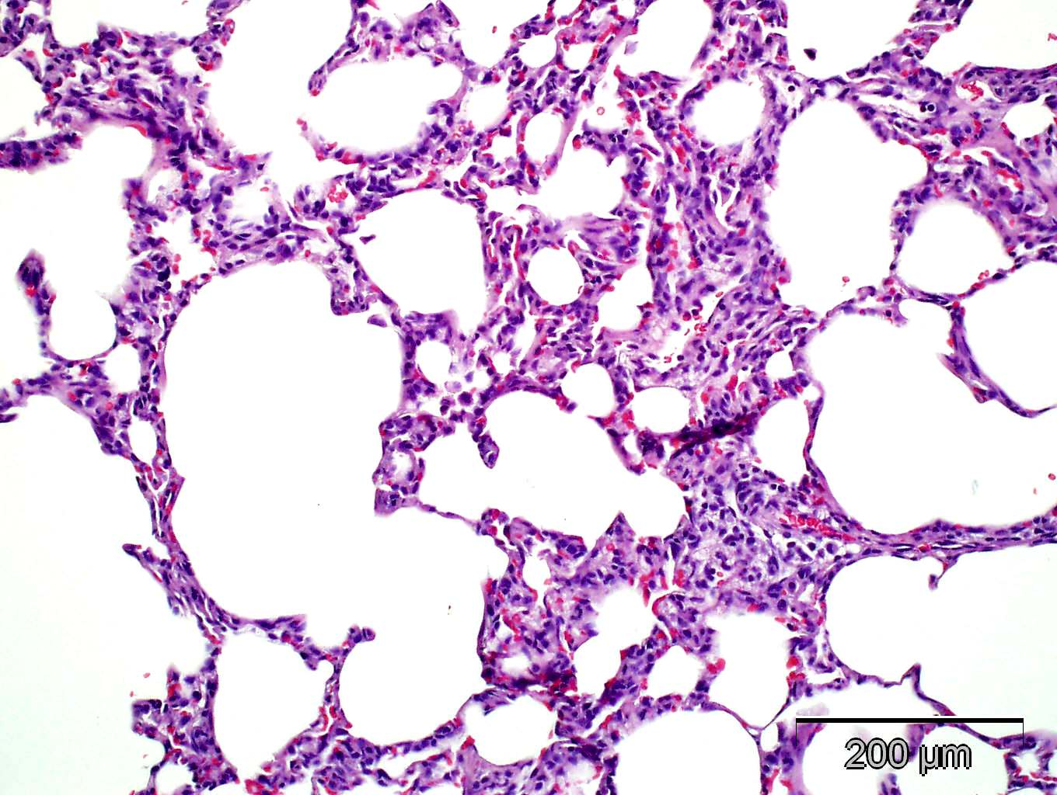
Histologic Findings
A TRANSLATIONAL APPROACH TO PRECLINICAL RESEARCH
Normal lung
Hyperox-lung
152
Hyperox-lung
805
Hyperox-lung
904
851
Hyperox-lungs: There is thickening of the alveolar walls, with inflammation, edema, and hemorrhage and consequently reduced alveolar area

Slide 7
Immunohistochemistry
A TRANSLATIONAL APPROACH TO PRECLINICAL RESEARCH
IHC assessments may include
Collagen Type I*
SMA 1*
CD68*
vWF*
CD8
PCNA*
KI67
*clear differences between normal air and hyper-oxygen

Slide 8
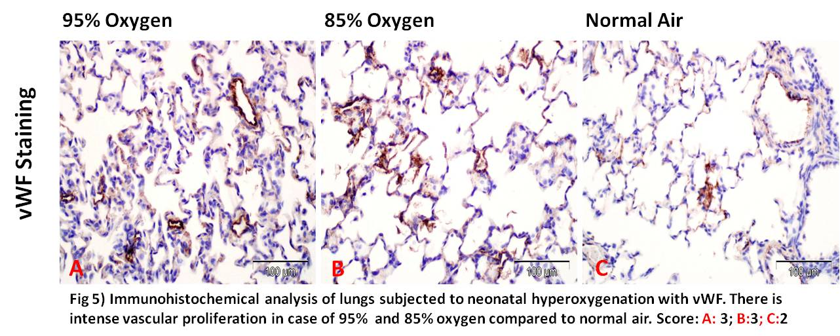
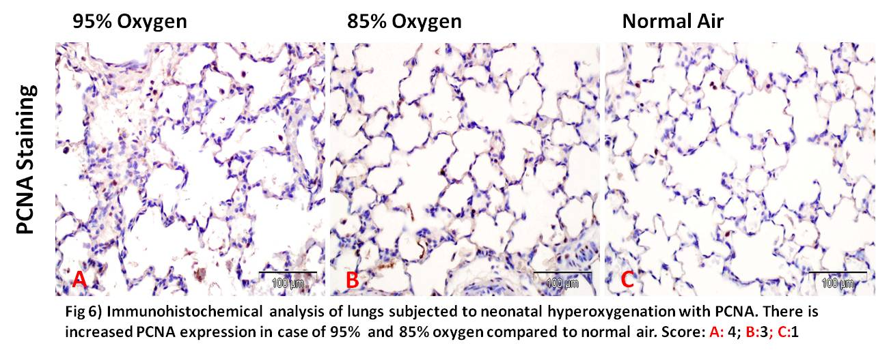
Hyper-oxygen-induced increases in vWF, PCNA.
A TRANSLATIONAL APPROACH TO PRECLINICAL RESEARCH

Slide 9
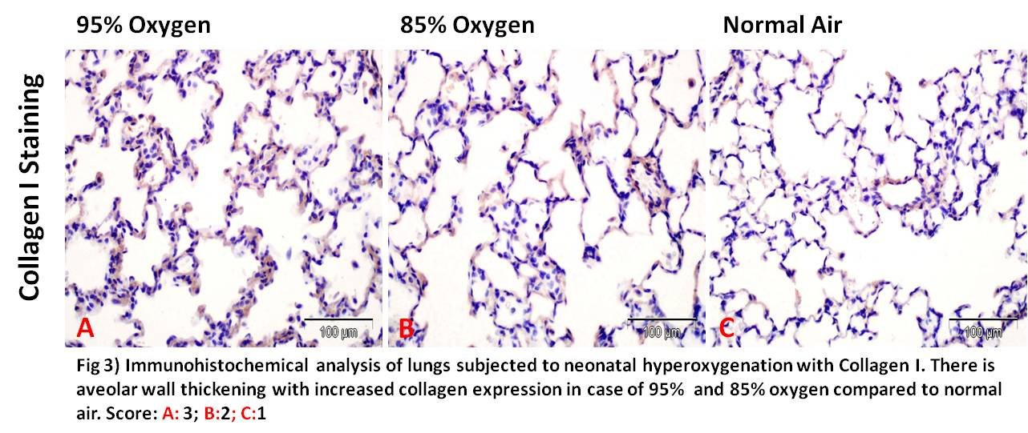
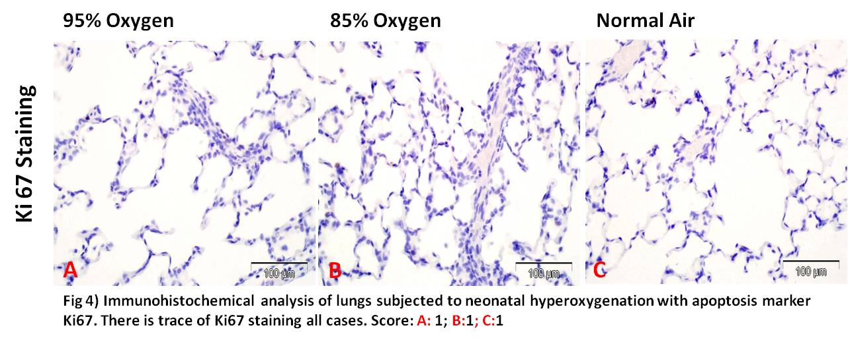
A TRANSLATIONAL APPROACH TO PRECLINICAL RESEARCH
Hyper-oxygen-induced increases in Collagen I. Minimal changes in KI67

Slide 10
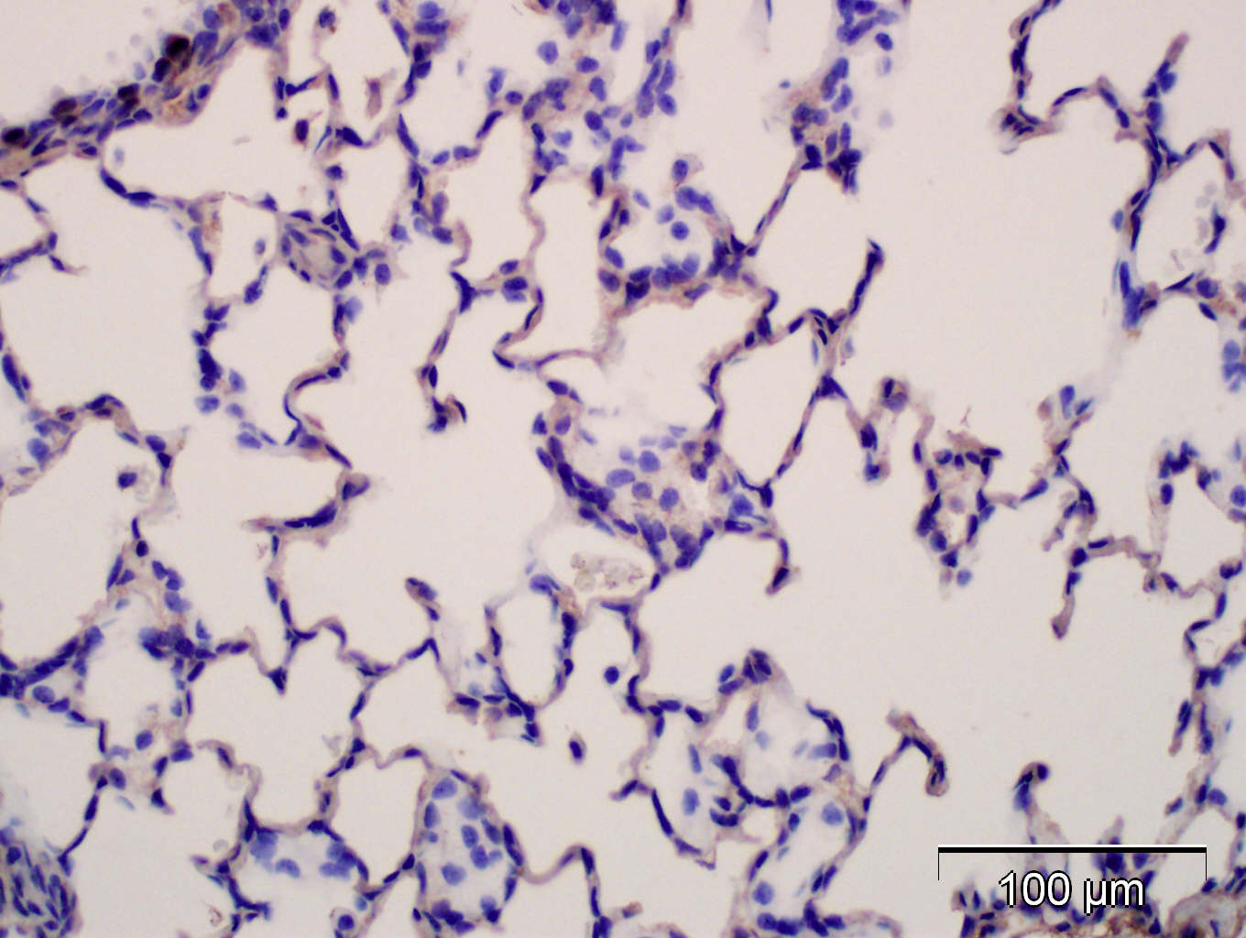
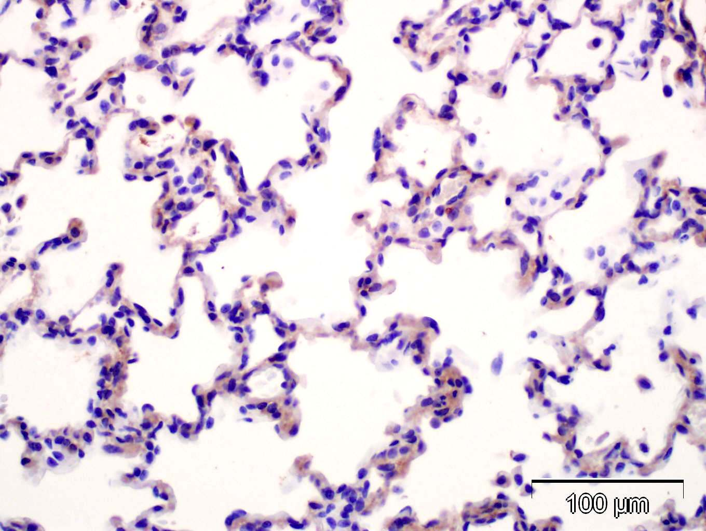
Immunohistochemistry
A TRANSLATIONAL APPROACH TO PRECLINICAL RESEARCH
Collagen Type I: Increased expression in alveolar walls of hyper-oxygenated lungs

Slide 11
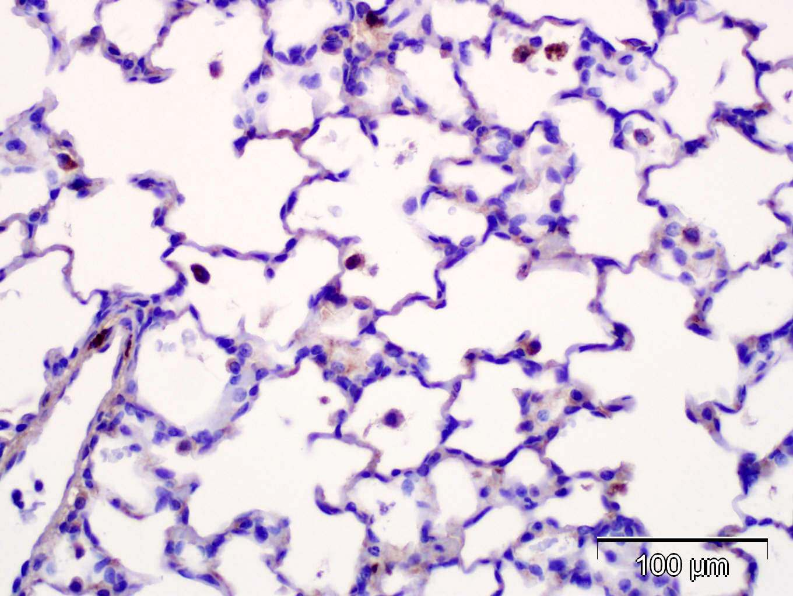
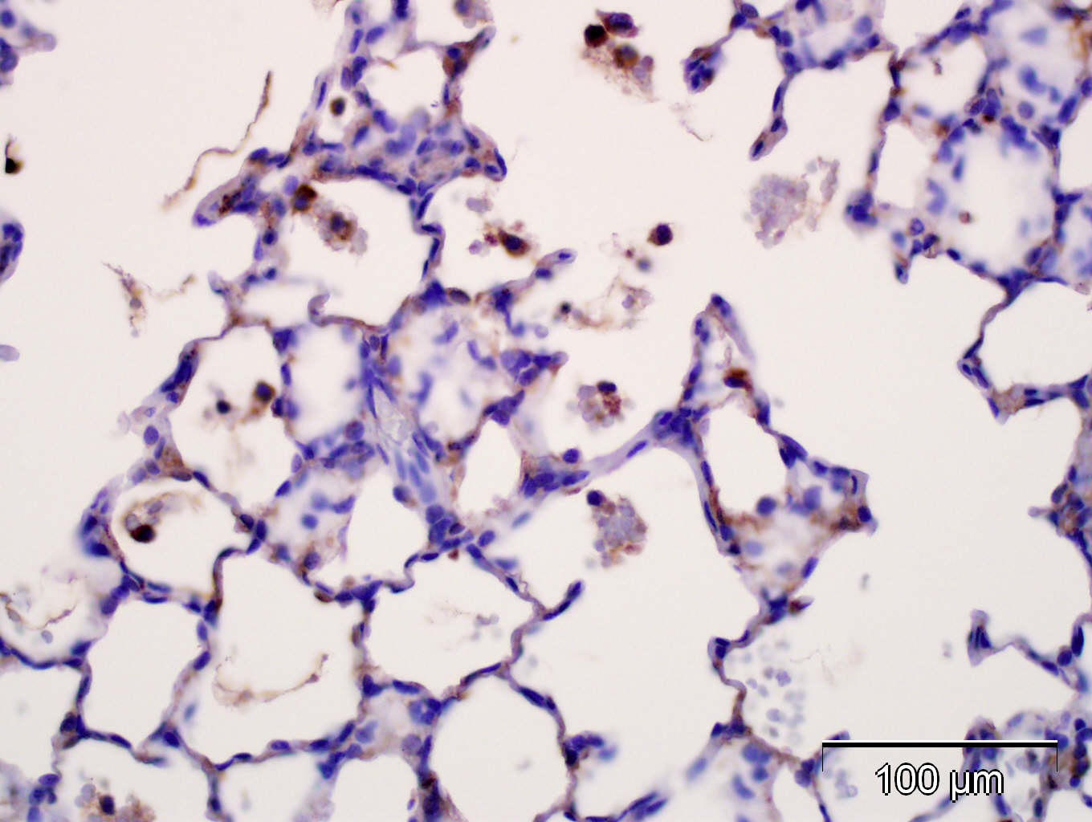
Immunohistochemistry
A TRANSLATIONAL APPROACH TO PRECLINICAL RESEARCH
CD68 Pan-macrophage: Increased numbers of CD68 macrophages in alveolar walls of hyper-oxygenated lungs

Slide 12
Hyper-ox Model Validated at CBI Mean Linear Intercept
A TRANSLATIONAL APPROACH TO PRECLINICAL RESEARCH
MLI is a common method to assess hyper-oxygen-induced changes in the alveolar walls
CBI conducted several studies assessing normoxic vs hyperoxic lungs
MLI assessments at CBI were compatible with literature references
Histopathologic lesion were compatible with literature references
Table 2A: Summary of MLI measurements
 | Normoxia (µm) | Hyperoxygenation (µm)
CBI MLI | 35.5 ± 0.06 | 44.3±5.3
Reference MLI Van Haaften, 2009 | ~35.5 ± 3 | ~50.3±2

Slide 13
Mean Linear Intercept Assessments
A TRANSLATIONAL APPROACH TO PRECLINICAL RESEARCH
Older method using a stage microscope and a microscopic grid. The number of times an alveolar wall, or septa, intersects with a grid line are manually counted.
Neonatal lungs respond to hyper-oxygenation by collagen deposition in the alveolar walls leading to thickening of the walls, and expansion of the alveolar space which leads to a reduction in the number of alveoli in a given area.
MLI is reduced in hyper-oxygenated lungs by about 22% in this model in comparison to normal lung alveoli (Van Haaften, 2009)

Slide 14
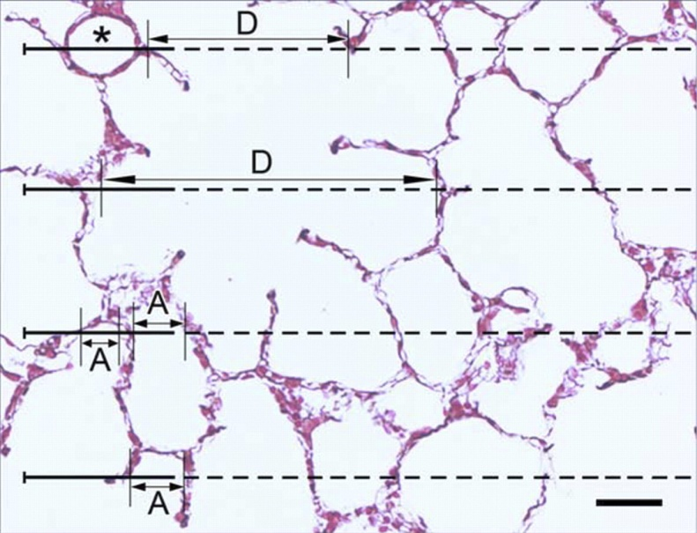
MLI Assessment
A TRANSLATIONAL APPROACH TO PRECLINICAL RESEARCH
MLI (mean linear intercept) is a method to measure this change. This is an older method that is very labor intensive and does not take histopathologic changes in the lung into consideration

Slide 15
A TRANSLATIONAL APPROACH TO PRECLINICAL RESEARCH
***
***
****
****
*
**
Group 1 3 7 8 9 10
Injection type V V NA NA V NA
Volume Injected 100ul 125ul NA NA 125ul NA
Dams Swapped Yes Yes Yes No No No
Hyperoxic
Normoxic
MLI values in a study demonstrating increased MLI values in hyperoxygenated pups in comparison the normal air. There is about a 20% increase in size.
Mean Linear Intercept of rat lung images after fixing with formalin and staining with hematoxylin and eosin at P28 (n=6 for Group 1/3/7, n=10 for Group 8, n=9 for Group 9/10). ns (blank) P>0.05; *P≤0.05; **P≤0.01; **P≤0.001; **P≤0.0001.

Slide 16
Phase Contrast Analysis
A TRANSLATIONAL APPROACH TO PRECLINICAL RESEARCH
CBI has developed a sophisticated histomorphometric phase contrast method
Method based in part upon Jacob, et al., 2009 and modified and enhanced and customized at CBI
Accurate and sophisticated
Reproducible
Reflects relevant changes in the alveolar wall thickness and changes in alveolar spaces
Validated and optimized for use in bronchopulmonary dysplasia

Slide 17
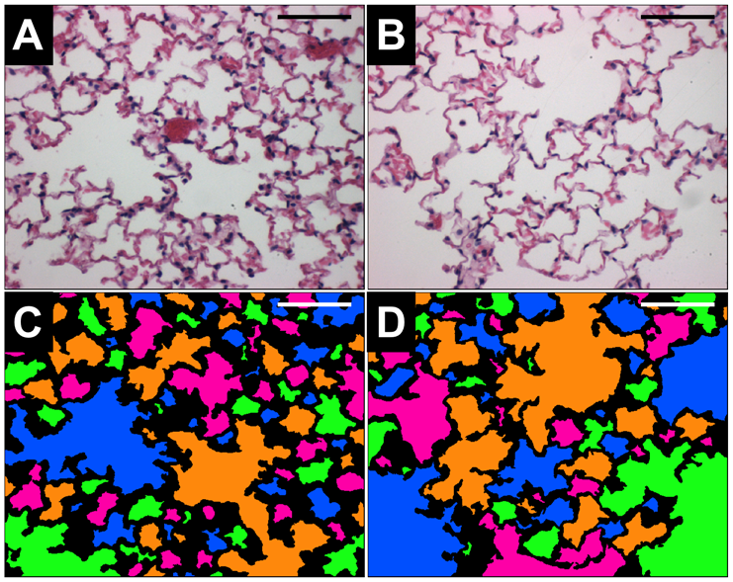
Example of PCA (Jacob, 2009 et al.) Analysis shows differences in alveolar wall thickness and alveolar space area.
A TRANSLATIONAL APPROACH TO PRECLINICAL RESEARCH

Slide 18
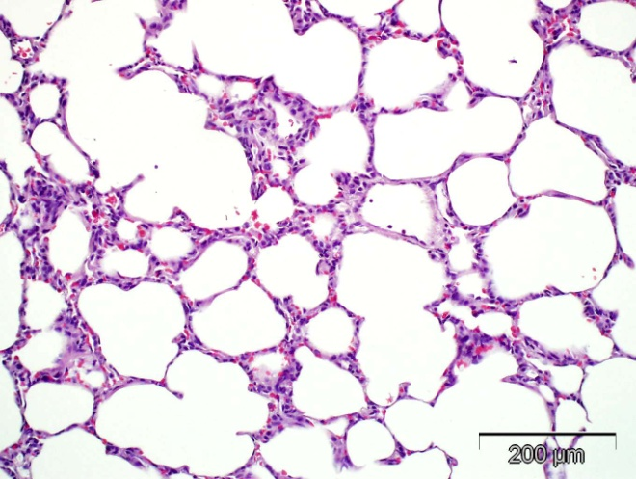
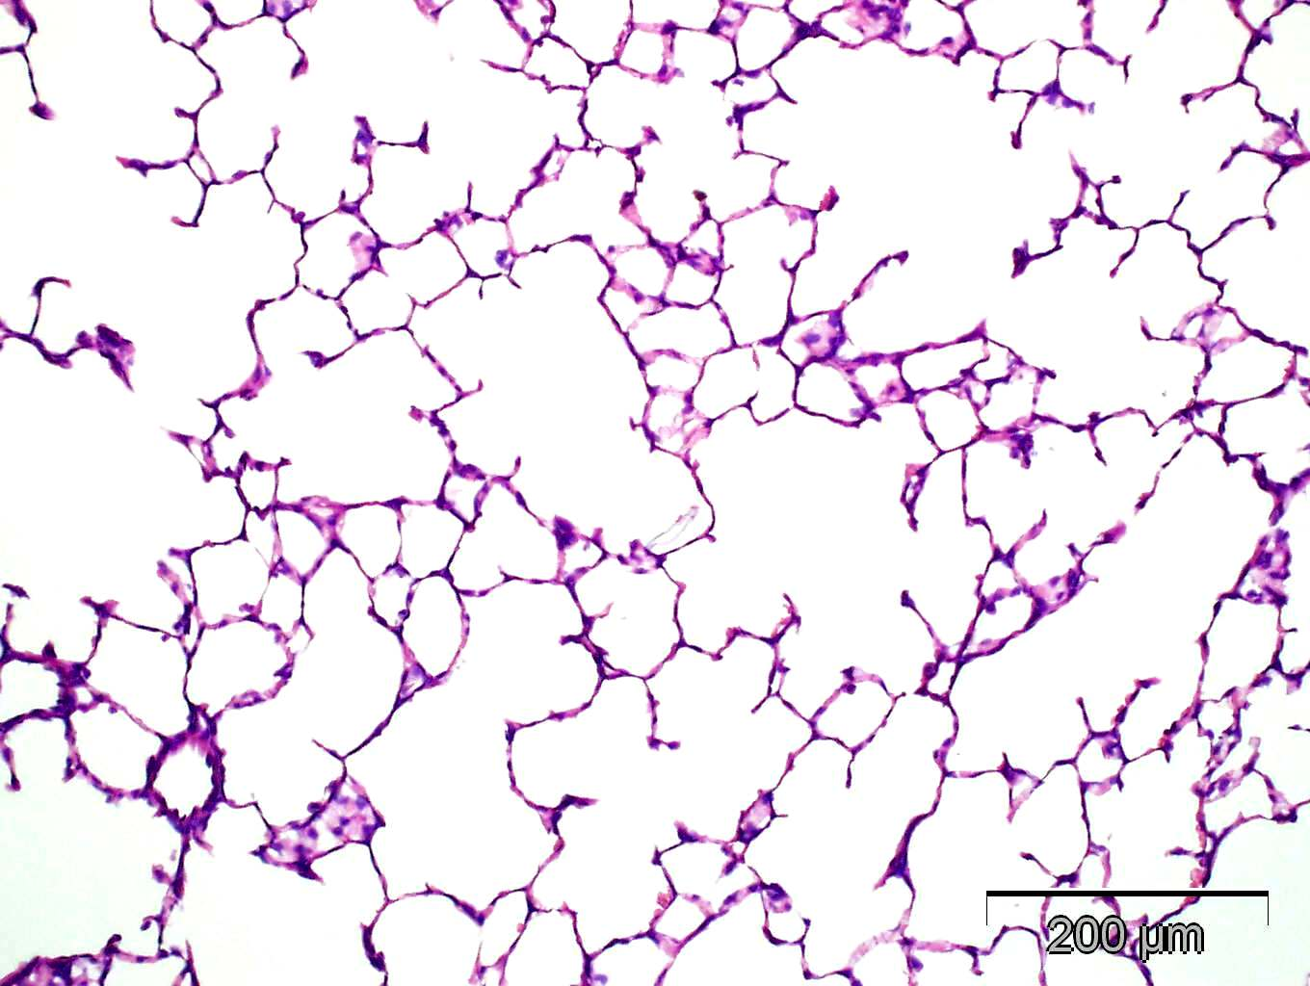
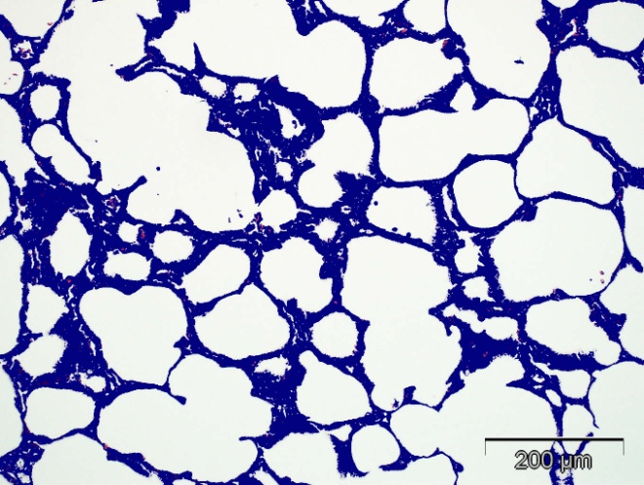
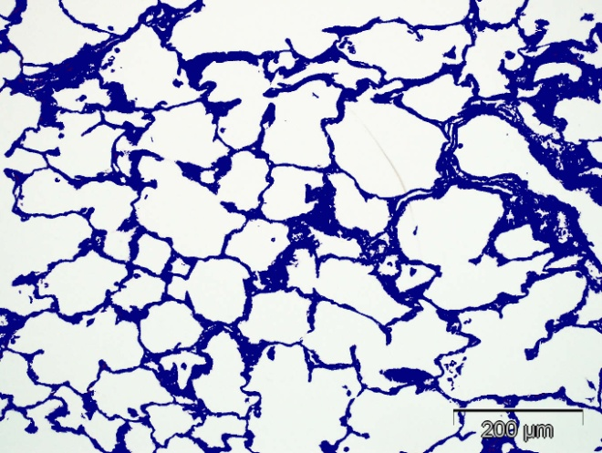
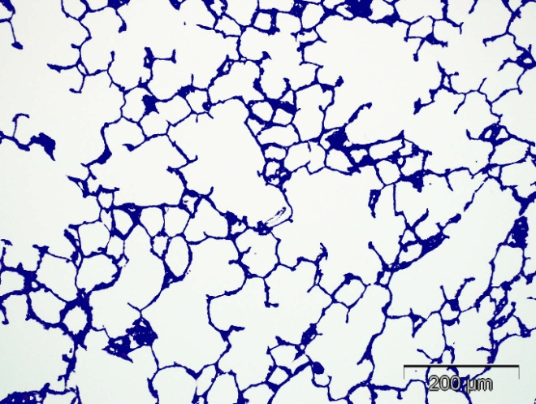
PCA at CBI: hyper-oxygen vs normal air. There are clear differences in alveolar wall thickness and alveolar space size
A TRANSLATIONAL APPROACH TO PRECLINICAL RESEARCH
A&B Hyperoxic O2
C Normal Air
A
B
C
D
D
F
Top: H&E Images of lungs in a hyperoxic chamber at high Oxygen (A&B) and normal air (C). Bottom: The corresponding pixel image analysis was shown in (D, E and F)

Slide 19
CBI PCA data showing clear significant increases in alveolar wall thickness
A TRANSLATIONAL APPROACH TO PRECLINICAL RESEARCH

Slide 20
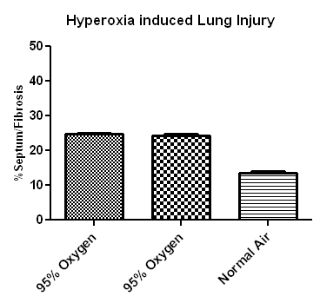
CBI PCA data showing clear significant increases in alveolar wall thickness
A TRANSLATIONAL APPROACH TO PRECLINICAL RESEARCH

Slide 21
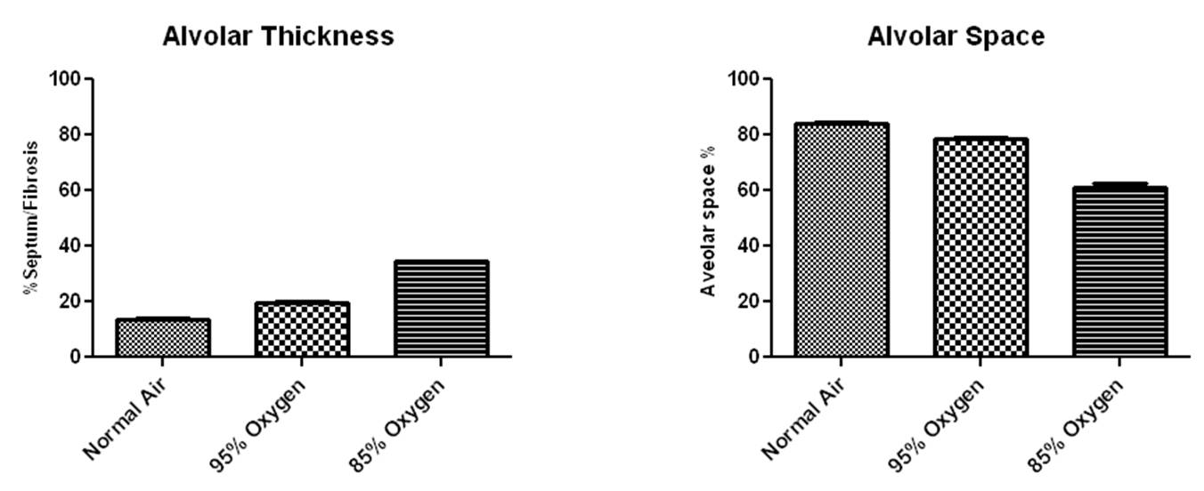
A TRANSLATIONAL APPROACH TO PRECLINICAL RESEARCH
CBI PCA data showing clear significant increases in alveolar wall thickness and differences in the area of the alveolar spaces

Slide 22
Summary
A TRANSLATIONAL APPROACH TO PRECLINICAL RESEARCH
CBI offers a validated model of hyper-oxygen-induced bronchopulmonary dysplasia in neonatal rats
Histopathologically there are changes in alveolar lumen size with increased alveolar wall thickness, decreases in alveolar area with inflammation present.
Histomorphometric phase analysis as developed and validated by CBI is consistent with the histologic changes and offers a more robust and accurate assessment of alveolar wall changes than MLI.
CBI PCA indicates a reliable increase in alveolar wall thickness and decrease in alveolar space

