Slide 1





CBI
Thermal Dermal Burn Modeling in Rats and Minipigs
A TRANSLATIONAL APPROACH TO PRECLINICAL RESEARCH
Comparative Biosciences, Inc.
786 Lucerne Drive
Sunnyvale, CA 94085
Telephone: 408.738.9261
www.compbio.com

Slide 2


Comparative Biosciences, Inc.
A TRANSLATIONAL APPROACH TO PRECLINICAL RESEARCH
Premier Preclinical Contract Research Organization
Specializing in Dermal and Ocular Pharmacology, Toxicology and Histopathology
17 Years in business
Located in the heart of Silicon Valley
State of the art, purpose-built facility
~30 employees with 7 PhDs, 2 pathologists
Experienced study directors and scientists
GLP, OECD, FDA, USDA, OLAW
AAALAC Accreditation

Slide 3
Model induction in MiniPigs
A TRANSLATIONAL APPROACH TO PRECLINICAL RESEARCH
CBI offers either full or partial thickness dermal burn modeling in minipigs that demonstrates dermal healing and is also humane and well tolerated by the rat and pig
  Uniform full or partial thickness burns are surgically-induced under strict aseptic conditions with intense post surgical care, systemic antibiotics and pain control.
  Device used is a stainless steel or brass block of defined weight (generally 300 gm) approximately 3x3 cm that is heated to a defined temperature (either 100 or 200C for partial or full thickness respectively) and held onto the skin for a defined time (generally 1 min for partial and 30 sec for full thickness). Alternatively, for partial thickness burns, hot water method (scald) may be used.
  Test article and bandaging is administered appropriately
  Grafting, escharectomy and other procedures available
  Lesions are measured and photographed
  Biopsy or histopathology for histology, IHC or bioanalysis may be performed

Slide 4
Model induction in Rats
A TRANSLATIONAL APPROACH TO PRECLINICAL RESEARCH
CBI offers either full or partial thickness dermal burn modeling in rats that demonstrates dermal healing and is also humane and well tolerated by the rat
  Uniform full or partial thickness burns are surgically-induced under strict aseptic conditions with intense post surgical care, systemic antibiotics and pain control.
  Device used is a small aluminum rod that is heated to a defined temperature (either 100 or 200C for partial or full thickness respectively) and held onto the skin for a defined time (generally 30 sec min for partial and 45-60 sec for full thickness). Alternatively, hot water method may be used.
  Test article and bandaging is administered appropriately
  Lesions are measured and photographed
  Biopsy or histopathology for histology, IHC or bioanalysis may be performed

Slide 5
Typical Parameters for both pigs and rats
A TRANSLATIONAL APPROACH TO PRECLINICAL RESEARCH
  Daily to weekly body weights
  Daily clinical observations
  Food consumption
  Clinical pathology
  Toxicokinetics or pharmacokinetics
  Measurements and photography
  Necropsy or site biopsy
  Histopathology with special staining
  Sponsor specific bioassays

Slide 6
Typical findings for both pigs and rats for standard parameters
A TRANSLATIONAL APPROACH TO PRECLINICAL RESEARCH
  For typical burn studies in which focal burns are placed on the dorsum:
    Procedure is well tolerated with adequate pain relief
    Daily to weekly body weights: There is mild body weight loss over the first week with return to weight gain after 1 week
    Daily clinical observations: Animals may be slightly lethargic
    Food consumption: No change or slight qualitative decrease
    Clinical pathology: Within normal limits
    For extensive burns (>50%) changes are seen in clinical pathology including glucose, total protein, albumin, LDH, insulin, BUN

Slide 7
A TRANSLATIONAL APPROACH TO PRECLINICAL RESEARCH
Histopathology
Surgical biopsies during course of study as well as necropsy
Tissue stained with HE, trichrome, other stains upon request
IHC for various markers upon request
Digital image analysis for wound size, cellular infiltrates, inflammatory markers or other markers
Photomicroscopy

Slide 8
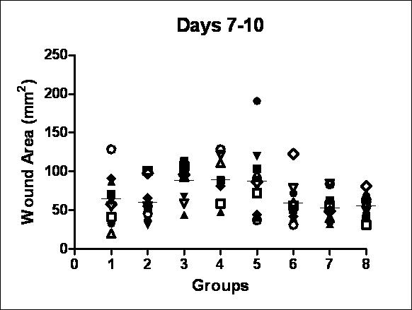
A TRANSLATIONAL APPROACH TO PRECLINICAL RESEARCH
Full thickness dermal wound area Days 7-10
Dermal burn area following placement of 2 dorsal full thickness burns and treated with various topical test articles. (N=8)

Slide 9
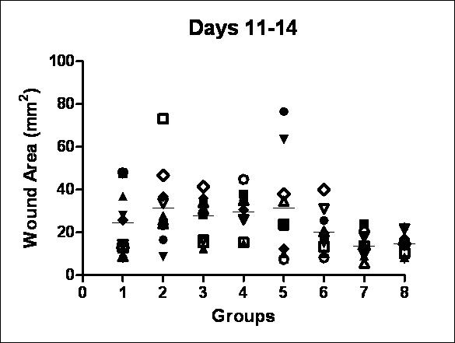
A TRANSLATIONAL APPROACH TO PRECLINICAL RESEARCH
Full thickness dermal wound area Days 11-14
Dermal burn area following placement of 2 dorsal full thickness burns and treated with various topical test articles. (N=8)

Slide 10
A TRANSLATIONAL APPROACH TO PRECLINICAL RESEARCH
Sample data from a minipig burn study
Data from several studies
Burn study using 2-4 pigs per group, treated with no treatment, vehicle and 5 topical compounds for 4 weeks
Six dorsal full thickness burns
Body weights, clinical observations
Wound area
Histopathology

Slide 11
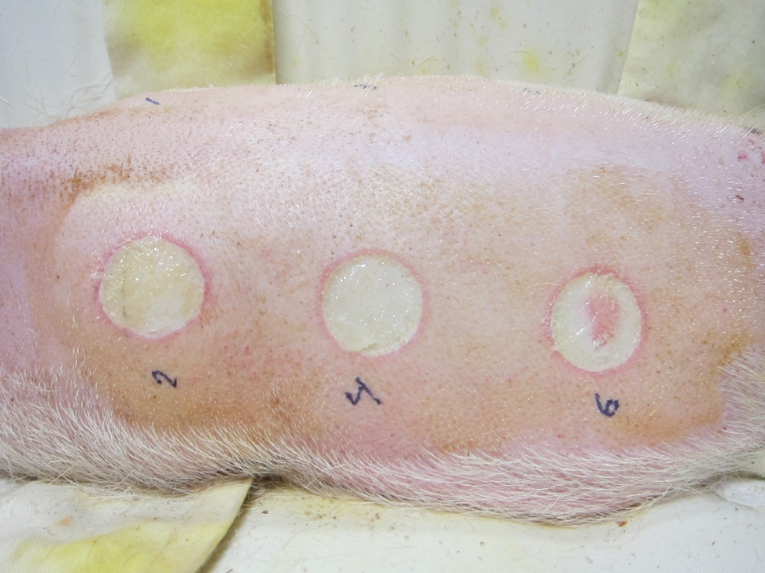
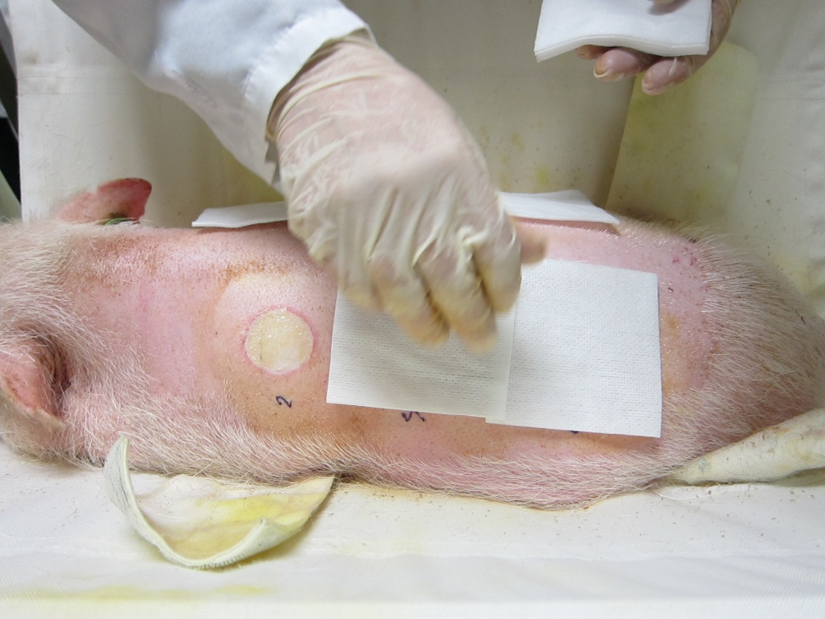
A TRANSLATIONAL APPROACH TO PRECLINICAL RESEARCH
Surgical procedures
Under strict aseptic conditions, burns are created.
Pig receives appropriate anesthesia, post operative pain control and antibiotics.
Sterile wound dressing with test article is applied as per protocol.

Slide 12
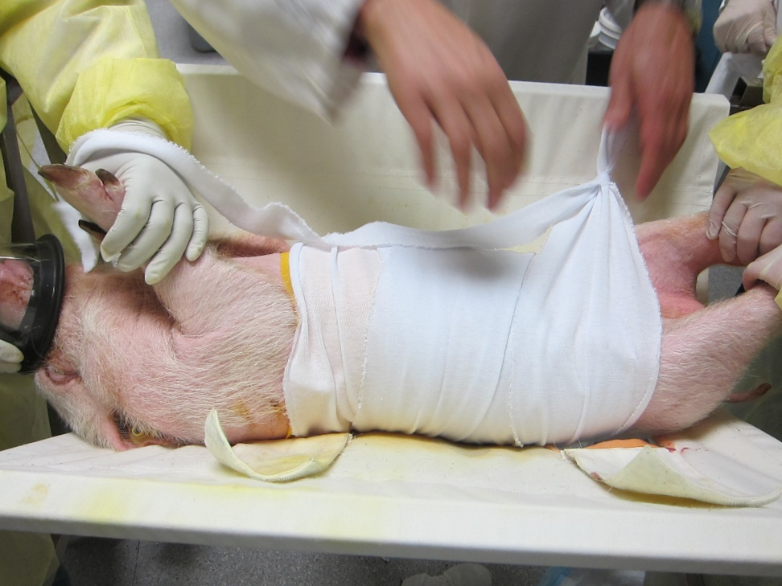
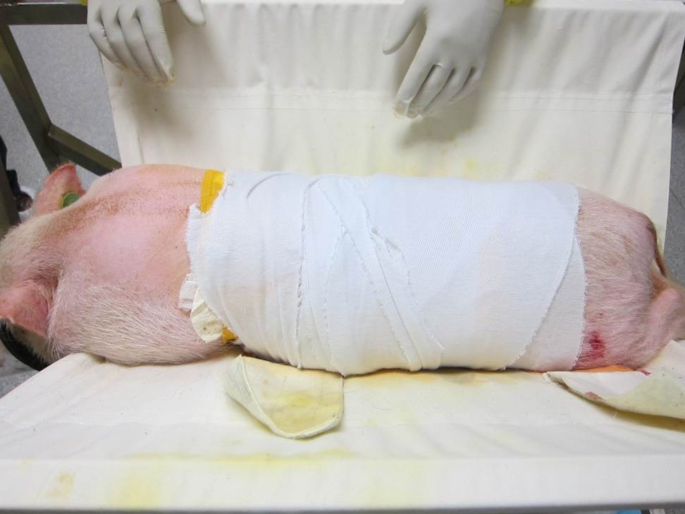
A TRANSLATIONAL APPROACH TO PRECLINICAL RESEARCH
Post-procedure bandaging
Stockinet covering
Bandage completed

Slide 13
A TRANSLATIONAL APPROACH TO PRECLINICAL RESEARCH
Burn research
Partial and full thickness burns are typically created
Mini pigs-skin is most similar to human and are a robust laboratory animal for this model
Healing and re-epithelialization are of interest
Biomarkers and cytokines are currently of interest and not well understood
Histology is well characterized at CBI

Slide 14
A TRANSLATIONAL APPROACH TO PRECLINICAL RESEARCH
Burn research
Burn progression is also of research interest
Following the initial burn, the lesion often worsens with time and is a significant adverse event
Progression is not well understood, but appears to be related to vascular injury, tissue oxygenation and mediate release.

Slide 15
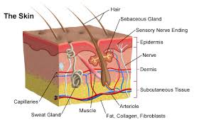
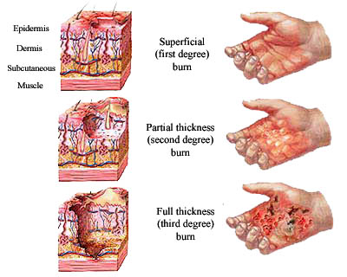
A TRANSLATIONAL APPROACH TO PRECLINICAL RESEARCH
Appearance of three types of burns: Full thickness burns extend to the underlying muscle layer

Slide 16
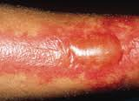
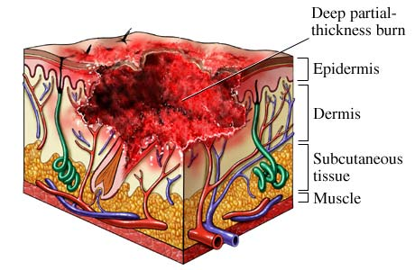
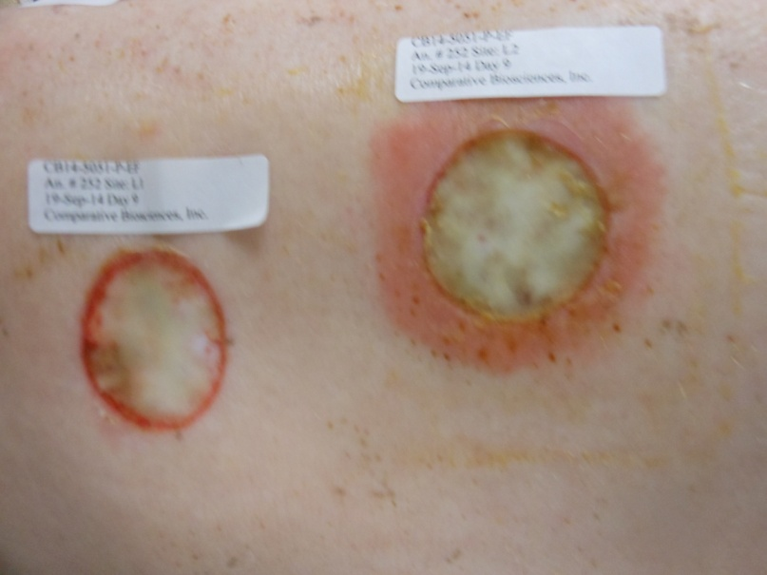
A TRANSLATIONAL APPROACH TO PRECLINICAL RESEARCH
Deep partial thickness burns or second degree burns in patient and in pig model.
Burn extends into the dermis, but not to the muscle layer.

Slide 17
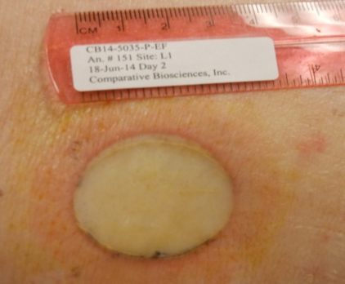
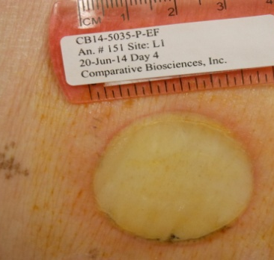
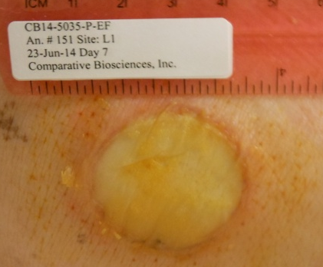
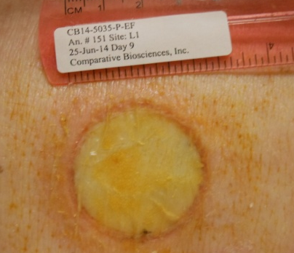
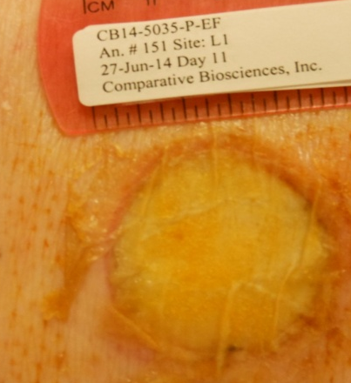
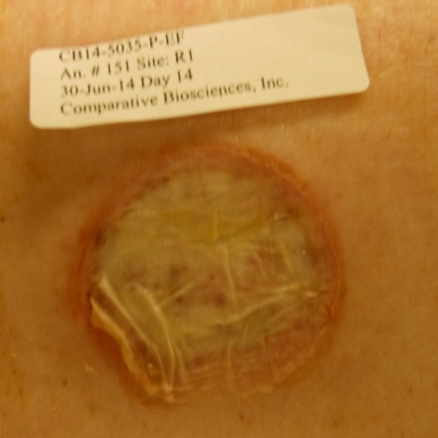
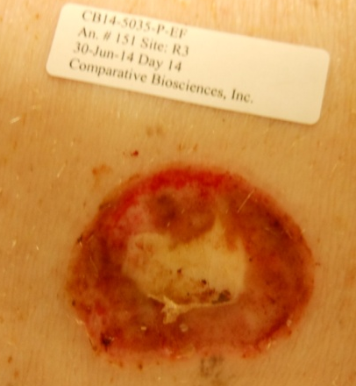
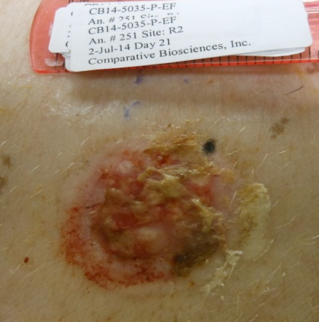
A TRANSLATIONAL APPROACH TO PRECLINICAL RESEARCH
Partial thickness burn Day 1:
Day 1-8 Focal area of blister and rim of hyperemia and edema.
Day 11-21 Progressive re-epithelialization and healing

Slide 18
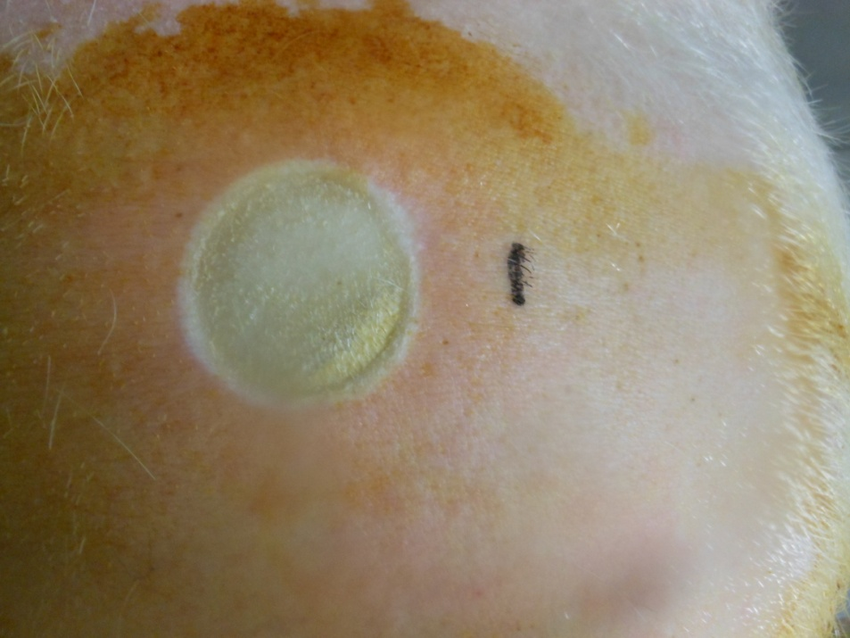
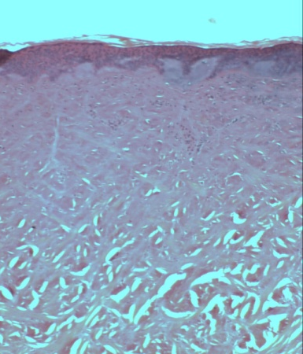
A TRANSLATIONAL APPROACH TO PRECLINICAL RESEARCH
Deep partial thickness burns or second degree burns in patient and in pig model.
The epithelium is still intact, but the superficial underlying collagen is bluish and amorphous. Vascular and cellular events have not yet occurred. Deeper collagen is not as effected.

Slide 19
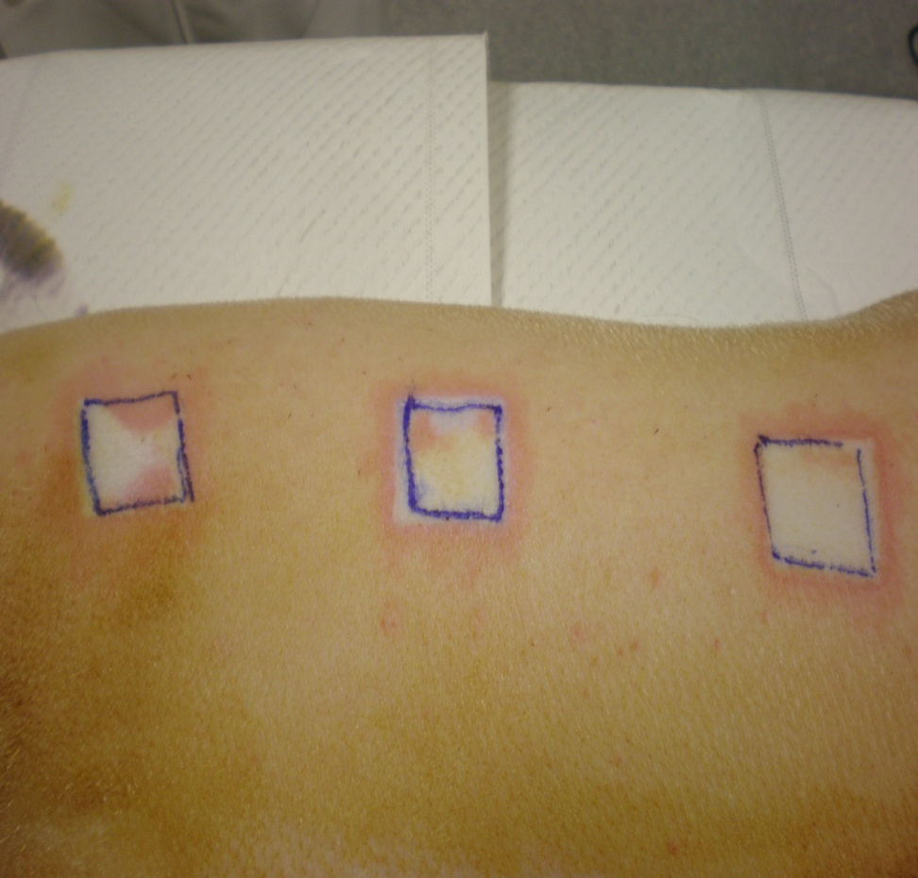
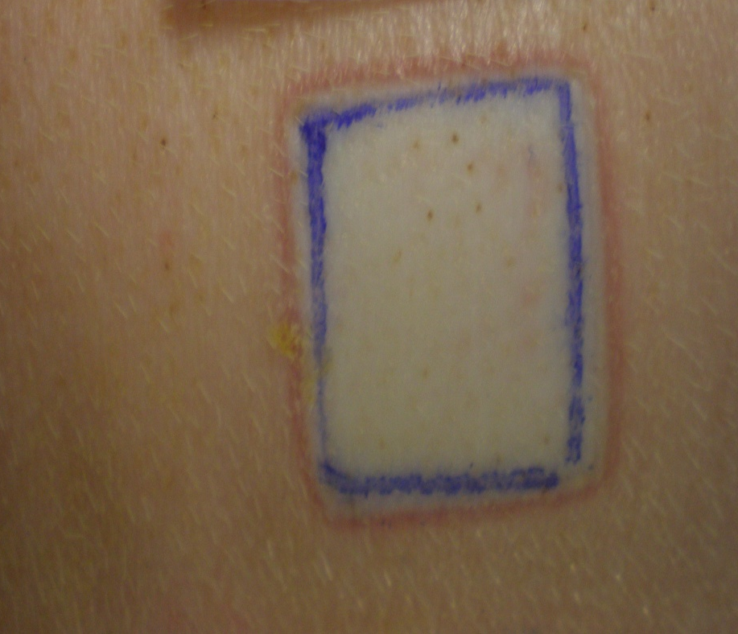
A TRANSLATIONAL APPROACH TO PRECLINICAL RESEARCH
Partial thickness burns-Day 1
Day 1: Acute thermal damage to the epidermis post surgically. Note hyperemic zone at burn-dermis interface..
Day 1: Acute thermal damage to the epidermis. Note hyperemic zone at burn-dermis interface.

Slide 20
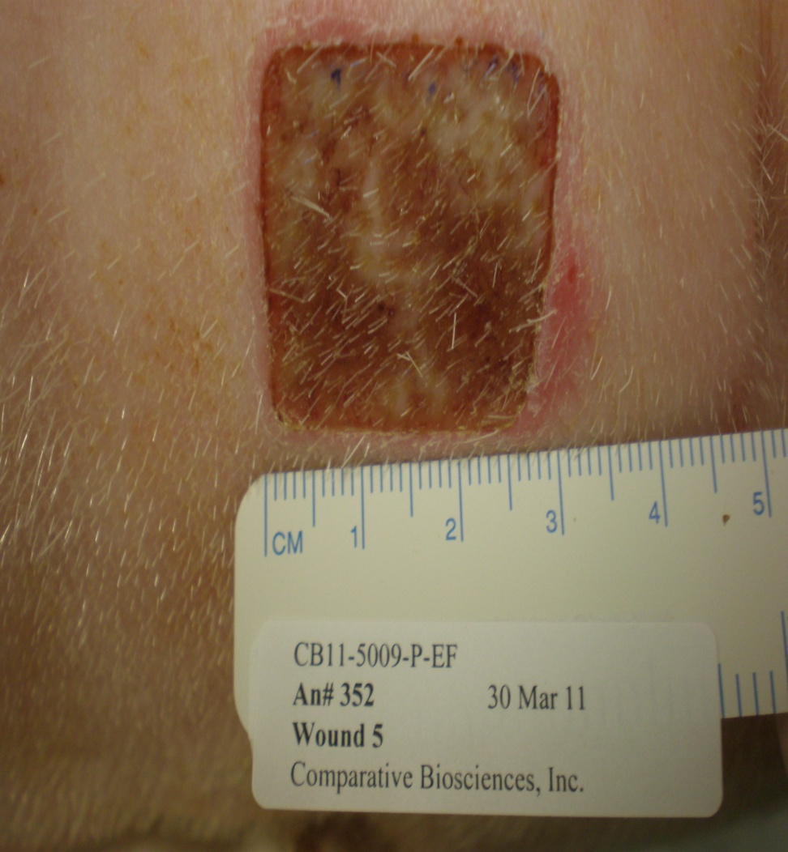
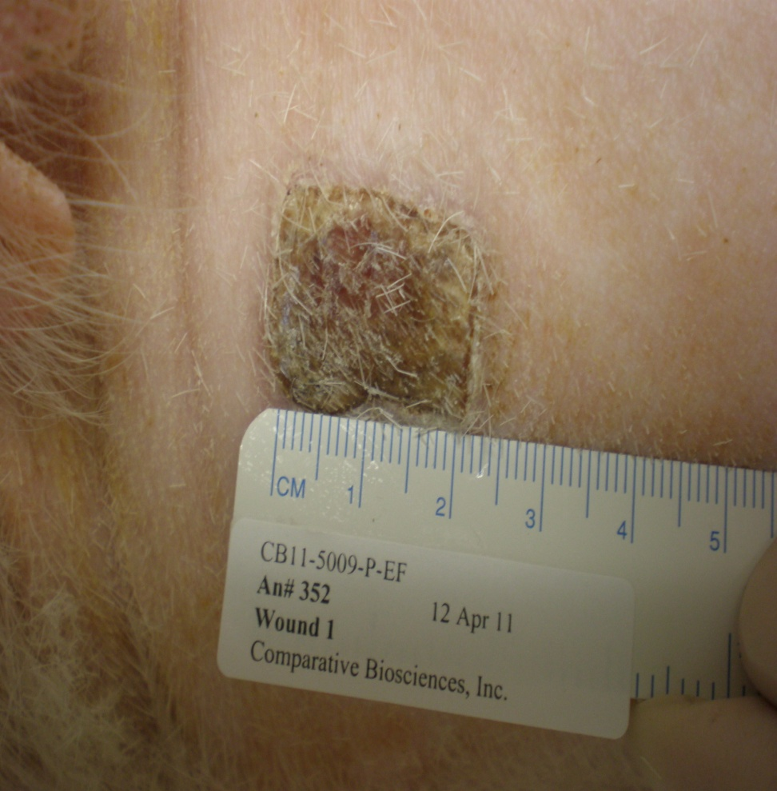
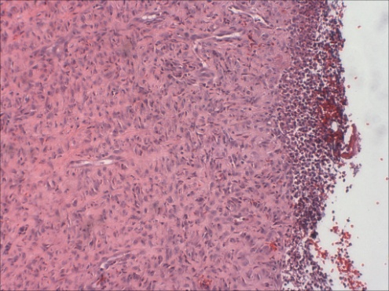
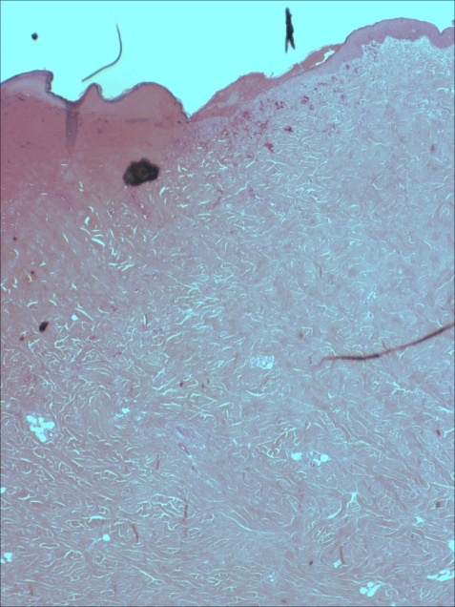
A TRANSLATIONAL APPROACH TO PRECLINICAL RESEARCH
Partial thickness burn-Day 8 and 21
Day 8-Dense scab formation. There is little re-epithelialization but dense new granulation tissue with inflammation is present in the wound bed
Day 8-Dense scab formation. There is little re-epithelialization but dense new granulation tissue with inflammation is present in the wound bed

Slide 21
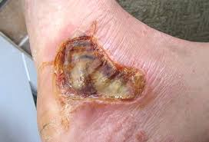
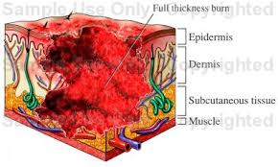
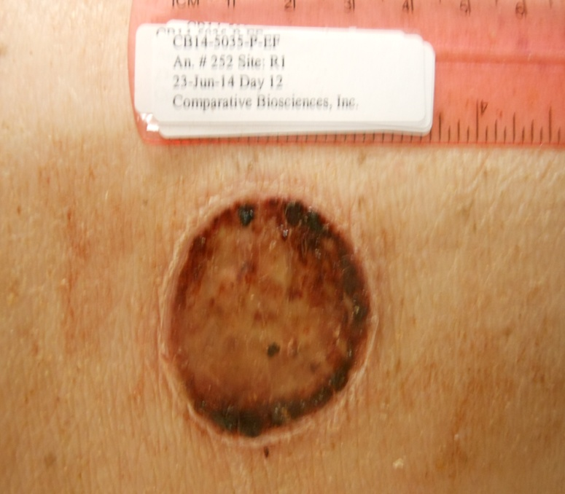
A TRANSLATIONAL APPROACH TO PRECLINICAL RESEARCH
Full thickness or 3rd degree burns. Damage extends to the underlying muscle.

Slide 22
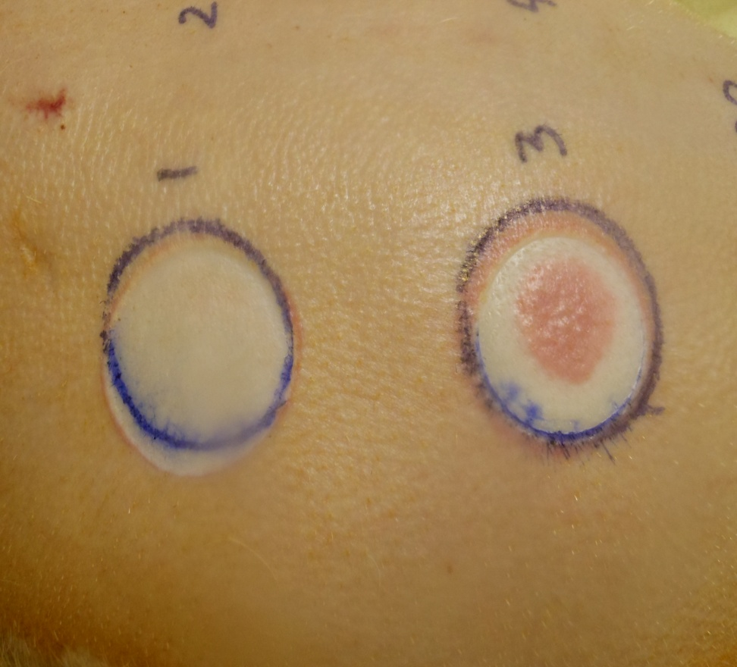
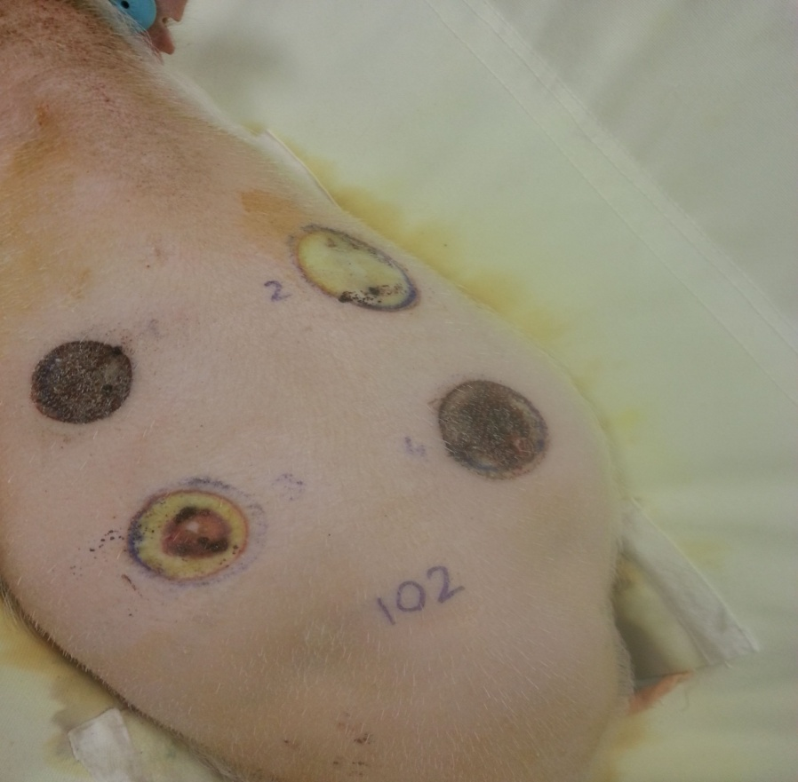
A TRANSLATIONAL APPROACH TO PRECLINICAL RESEARCH
Full thickness burns-increased heat and time exposure
Day 1: Acute thermal damage to the epidermis post surgically. Note hyperemic zone at dermis-burn interface
Day 8: The surface is necrotic with a deep escharotic crust overlying the lesion

Slide 23
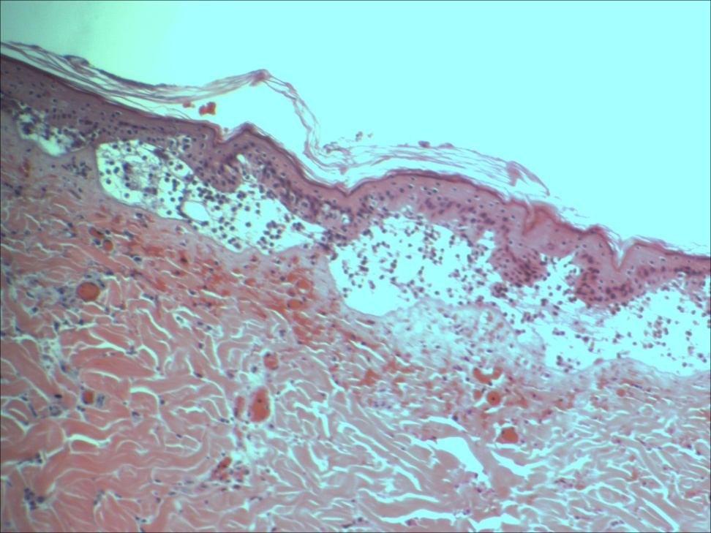
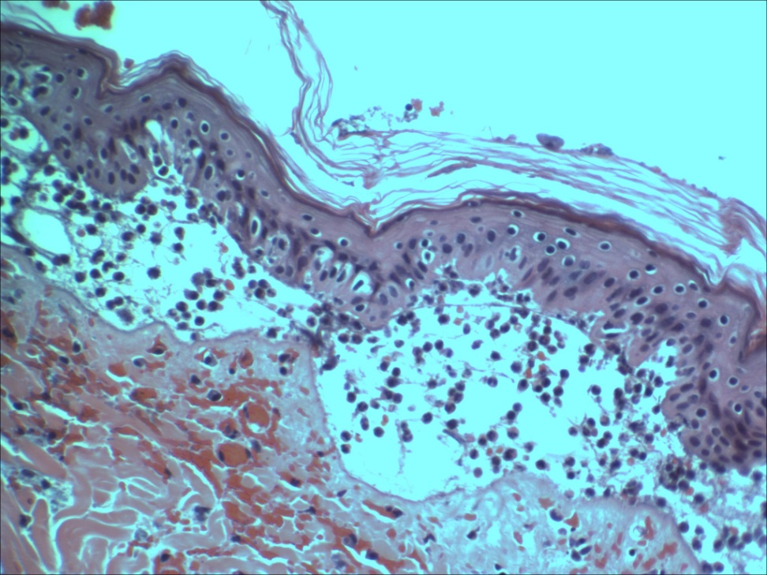
A TRANSLATIONAL APPROACH TO PRECLINICAL RESEARCH
Histology, full thickness, with loss of epithelium-2 days
Full thickness burn, 2 days. There is a blister with separation of the epithelium from the underlying dermis. There are large, fluid fill blisters containing large numbers of neutrophils. The underlying dermis is exposed with inflammation, edema, hemorrhage and congestion. 40x HE
Full thickness burn, 2 days. There is a blister with separation of the epithelium from the underlying dermis. There are large, fluid fill blisters containing large numbers of neutrophils. The underlying dermis is exposed with inflammation, edema, hemorrhage and congestion. 40x HE

Slide 24
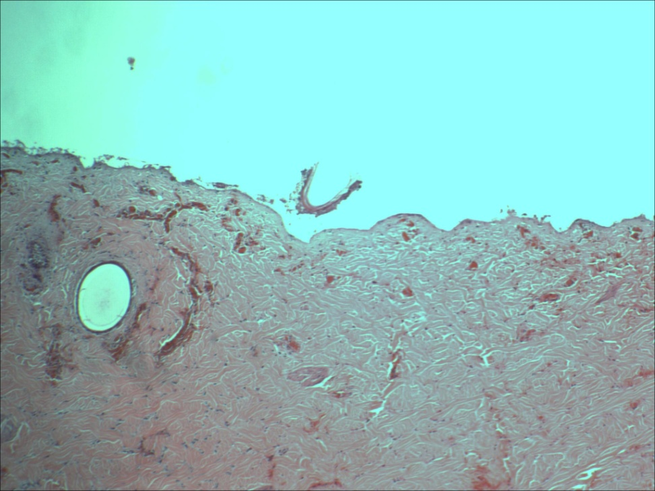
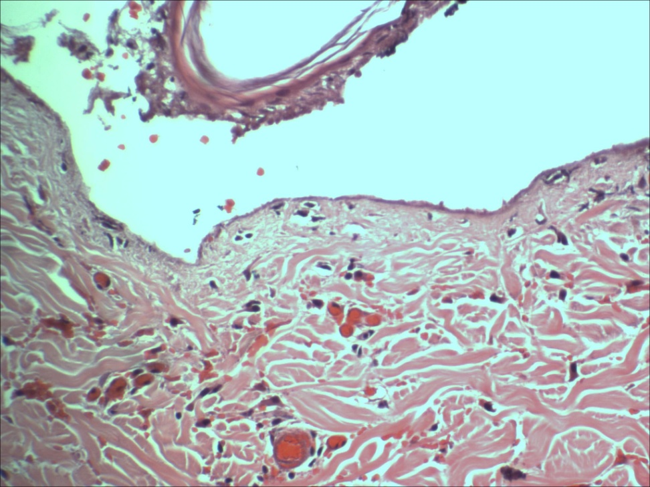
A TRANSLATIONAL APPROACH TO PRECLINICAL RESEARCH
Histology, full thickness, with loss of epithelium-3 days
Full thickness burn, 3 Days. There is complete loss of epithelium 40x HE
Full thickness burn, 3 days, with complete loss of epithelium. The underlying dermis is exposed with inflammation, edema, hemorrhage and congestion. 40x HE

Slide 25
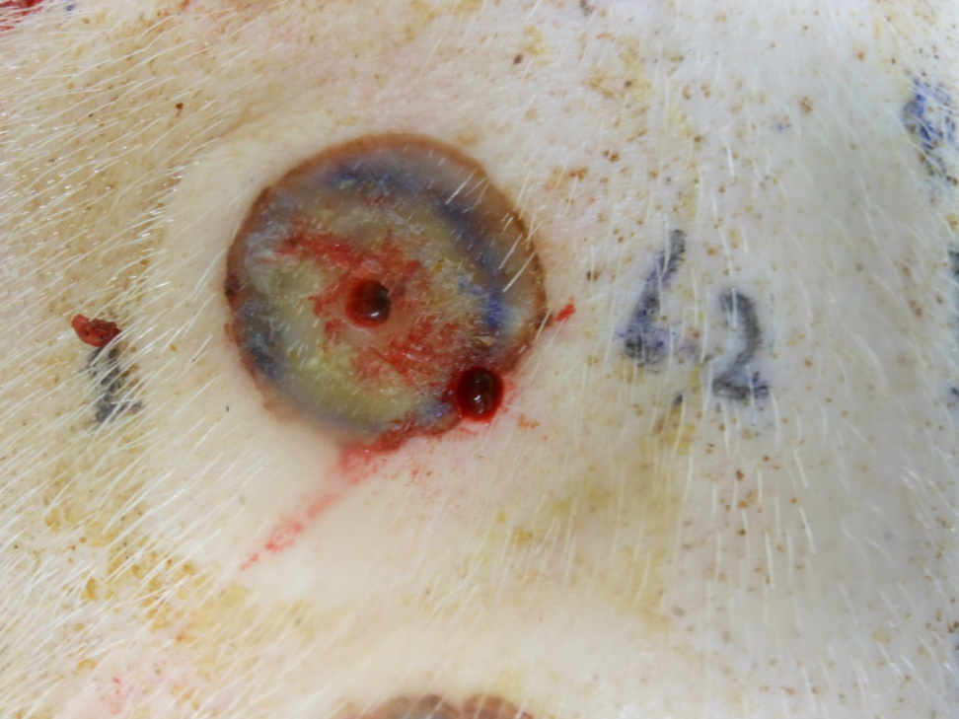
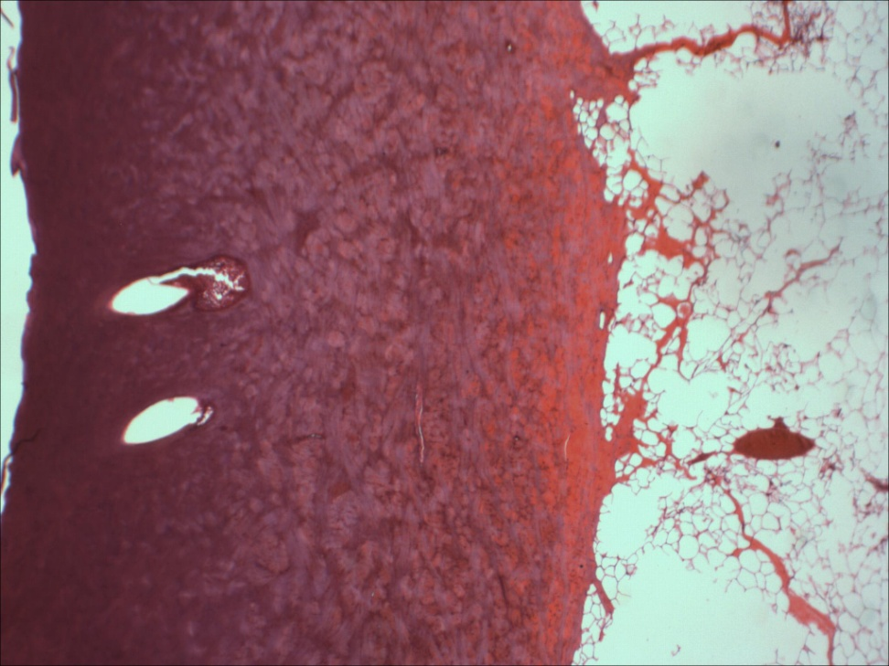
A TRANSLATIONAL APPROACH TO PRECLINICAL RESEARCH
Full thickness burns-increased heat and time exposure-Day 3 biopsy with histology
Day 3: Acute thermal damage to the epidermis post surgically. Note hyperemic zone at dermis-burn interface. The center of the burn has been biopsied under brief general anesthesia
Histology Day 3: Full thickness acute thermal damage to the epidermis post -surgically. Note that thermal damage extends through the dermis into the deep adipose tissue. HE 10x

Slide 26
A TRANSLATIONAL APPROACH TO PRECLINICAL RESEARCH
Lesion development-Full thickness; Day 14
Day 14
Epithelium partially complete or nearly complete covering
Epithelium is thickened in comparison to normal epithelium (2-3x as thick) at edges, but may be very thin in the center
Epithelial hyperplasia is common at edges
Underlying collagen is consistent with granulation tissue
Thick eschar and crust present

Slide 27
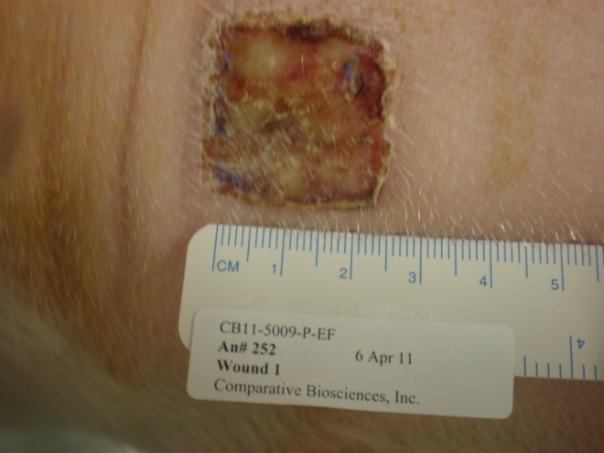
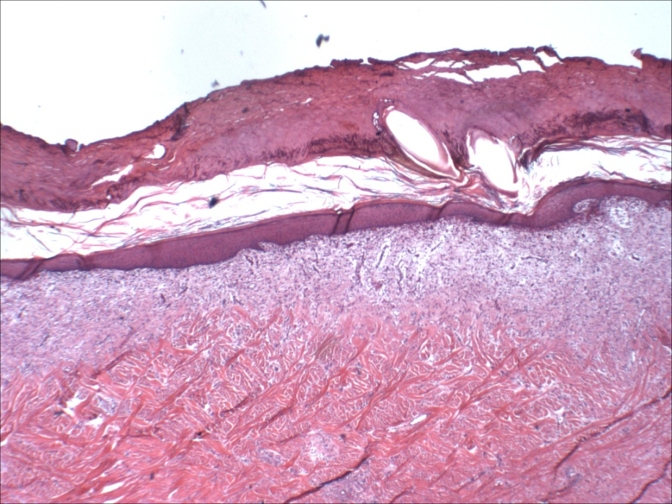
A TRANSLATIONAL APPROACH TO PRECLINICAL RESEARCH
Full thickness Day 14
There is crust formation with a thickened epithelium, There is edema and inflammation primarily of the superficial dermis and formation of more mature granulation tissue filling the wound bed.

Slide 28
A TRANSLATIONAL APPROACH TO PRECLINICAL RESEARCH
Lesion development-Full thickness; Day 28
Day 28+
Epithelium complete or nearly complete covering
Epithelium is thickened in comparison to normal epithelium (2-3x as thick)
Epithelial hyperplasia is common
Underlying collagen is more mature with normal orientation
Thick eschar and crust present

Slide 29
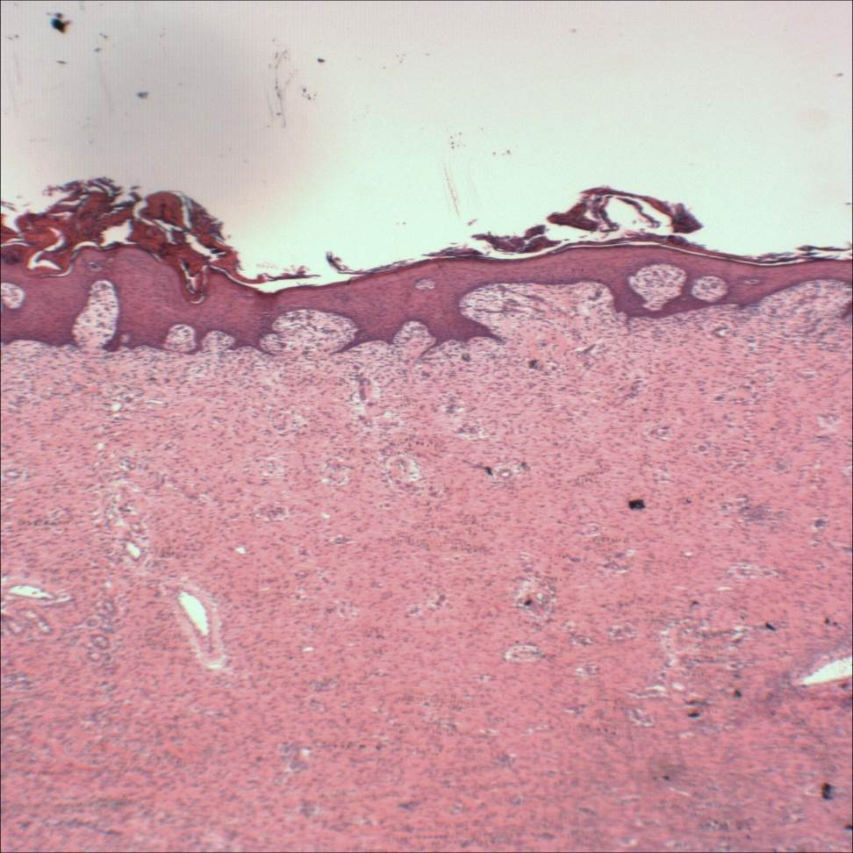
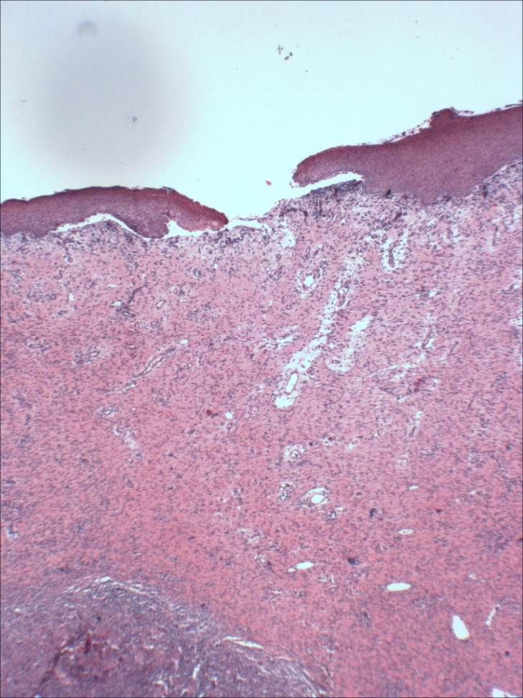
A TRANSLATIONAL APPROACH TO PRECLINICAL RESEARCH
Full thickness Day 28
Day 28 Histologically, the epithelium is covering all or most of the wound bed and is hyperplastic. There is a dense fibrous wound bed with collagen, neovascularization and mild inflammation.
Macroscopically, there is re-epithelializaton and healing of the wound with some small scabbing.
Day 28 The epithelium is covering all or most of the wound bed and is hyperplastic. There is a dense fibrous wound bed with collagen, neovascularization and mild inflammation

Slide 30
A TRANSLATIONAL APPROACH TO PRECLINICAL RESEARCH
Histologic scoring
Semi-quantitative
Industry standard 0-4 severity for
  Inflammation
  Re-epithelialization
  Collagen formation
  Epithelial hyperplasia
Quantitative
  Measure entire wound length and measure amount of new epithelial covering and determine percentage

Slide 31
A TRANSLATIONAL APPROACH TO PRECLINICAL RESEARCH
Histologic scoring
TA 1
Mean Histological Scores following partial thickness burns in 4 minipigs treated with vehicle, silver sulfadiazine and two test articles. The test articles, vehicle and positive control all positively effected the burn resolution.

Slide 32
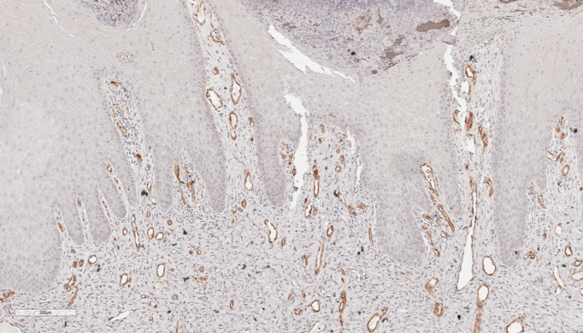
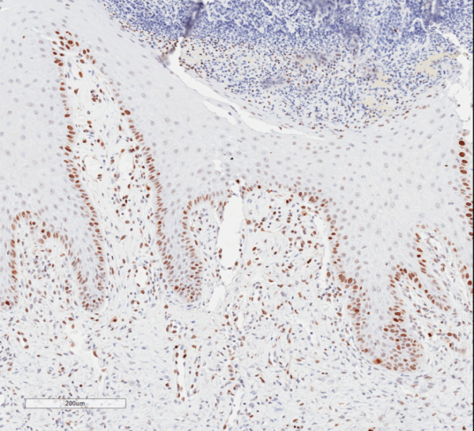
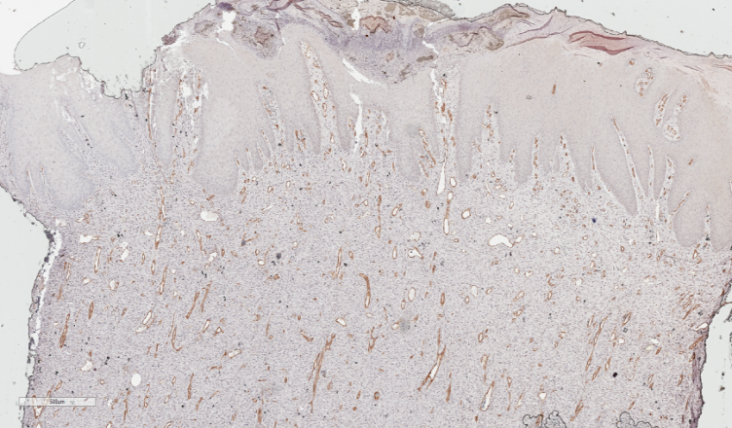
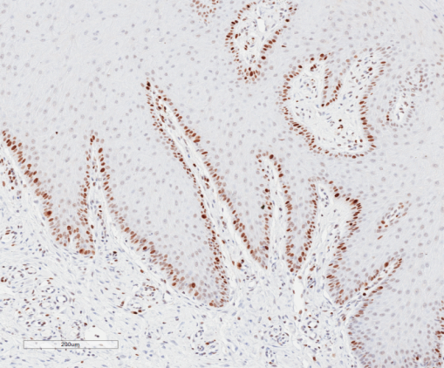
A TRANSLATIONAL APPROACH TO PRECLINICAL RESEARCH
Histologic scoring
CD31 and KI67 IHC demonstrating marked increases in the burn site at 20 days consistent with tissue healing

Slide 33
A TRANSLATIONAL APPROACH TO PRECLINICAL RESEARCH
Summary
At CBI, we have developed and validated a consistent and reproducible model of partial and full thickness burns in minipigs
The lesion is uniform and consistent between sites on the same animal and between animals both macroscopically and microscopically.

